Slide 1
GB.2349: Trading in Cash and Derivatives Securities
Spring 2017
Class Notes
Prof. Stephen Figlewski
NYU Stern School of Business
KMEC 9-64
sfiglews@stern.nyu.edu
212-998-0712

Slide 2
What is Trading?
Silber and Smith, "What do traders do?"
market making
proprietary trading
  investing
  speculation
  According to Silber and Smith, "The overwhelming majority of traders at large financial institutions (9 out of 10) are marketmakers."
FINC-GB.2349 Spring 2017
Trading Cash and Derivative Securities ©2017 Figlewski

Slide 3
Overview of First Half
The main question is: How should an information trader try to behave in a financial market that is as "efficient" as ours are?
"Academic" finance has a lot to say about this question. The first half of the course will explore it from several angles:
How informationally efficient are our financial markets?
What kinds of trading strategies do and don't make sense in a pretty efficient market?
How should we test the performance of a potential trading strategy using statistical evidence?
Does technical analysis make sense? If so, why?
How do traditional investment strategies like "value," "momentum," and "carry" perform? How about the CAPM? What about Warren Buffett; doesn't his performance show something about market rationality and efficiency?
How rational or irrational are other investors?
Trading in options and other derivatives uses mathematical models for pricing and for risk management. How is this done in practice? How well does it work?
Volatility is the key factor in option pricing. How does it behave? How does volatility work as a new asset class? What are the new volatility-based derivatives about?
FINC-GB.2349 Spring 2017
Trading Cash and Derivative Securities ©2017 Figlewski

Slide 4
Efficient Markets
  Eugene Fama (1970) "Efficient Capital Markets: A Review of Theory and Empirical Work", defined the baseline position on market behavior for the entire academic finance profession.
  A verbal statement of Fama's "Efficient Markets Hypothesis" is:
  For every stock at every point in time, the expected value of the price next period given the information that is currently available is today's price plus an equilibrium "fair" rate of return.
  The key point is that the market price fully and accurately incorporates the information investors have right now.
  An investor with no information still earns a fair expected rate of return in the market simply by buying the stock.
  But no one can make excess returns more than is appropriate compensation for risk exposure using any information the market already has.
FINC-GB.2349 Spring 2017
Trading Cash and Derivative Securities ©2017 Figlewski

Slide 5
Efficient Markets
  Fama distinguishes 3 degrees of market efficiency:
    Weak form: Today's market price accurately reflects all information that can be extracted from a security's past history of prices and returns.
      You can't make excess returns trading on trends, momentum, reversals or chart patterns.
    Semi-strong form: Today's market price accurately reflects past prices and all other information that is publicly available.
      You can't make excess returns by studying the Wall Street Journal or financial statements.
    Strong form: Today's market price accurately reflects all information currently known by anyone.
      You can't ever make excess returns trading against the market, except by accident.
  No one believes our markets are strong form efficient, but there is a lot of evidence that they are quite efficient at the semi-strong form level.
FINC-GB.2349 Spring 2017
Trading Cash and Derivative Securities ©2017 Figlewski

Slide 6
On the other hand...
Keynes never believed the stock market was fully efficient. He said it was like a "beauty contest" with frequent disconnects between market prices and true values.
Professional investment may be likened to those newspaper competitions in which the competitors have to pick out the six prettiest faces from a hundred photographs, the prize being awarded to the competitor whose choice most nearly corresponds to the average preferences of the competitors as a whole; so that each competitor has to pick, not those faces which he himself thinks prettiest, but those which he thinks likeliest to catch the fancy of the other competitors, all of whom are looking at the problem from the same point of view. It is not a case of choosing those which, to the best of one's judgment, are really the prettiest, nor even those which average opinion genuinely thinks the prettiest. We have reached the third degree where we devote our intelligences to anticipating what average opinion expects the average opinion to be. And there are some, I believe, who practice the fourth, fifth, and higher degrees.
Keynes (The General Theory, ch. 12)
This feature makes the stock market different from games of chance with an exogenously determined payoff (e.g., a lottery) or from a derivatives market with a specific maturity.
FINC-GB.2349 Spring 2017
Trading Cash and Derivative Securities ©2017 Figlewski

Slide 7
Trading on Information
A basic question:
What is the most valuable kind of information for trading?
The true (long run) value of a given security?
The short run market price change, independent of fundamental value?
How can you predict these better than the market?
FINC-GB.2349 Spring 2017
Trading Cash and Derivative Securities ©2017 Figlewski

Slide 8
Trading on Information
A basic question, continued:
What is the most valuable kind of information for trading?
Something the rest of the market doesn't know?
Something the rest of the market does know, but doesn't understand correctly?
Something the rest of the market knows and understands but can't trade on?
FINC-GB.2349 Spring 2017
Trading Cash and Derivative Securities ©2017 Figlewski

Slide 9
Trading on Information
Resolution of Uncertainty
(When Do You Get the Payoff?)
Some markets and events produce unambiguous objective values at a known future date. You can win by correctly predicting the outcome.
horse races
lotteries
derivative contracts
The payoff may depend on how other people bet. With derivatives, the information you expect may arrive, but too late, after contract expiration.
Other strategies depend on market prices adjusting to properly reflect the information. You only win if your information is right and also the market comes to agree with you so the price goes to the level you expect.
stocks and most other assets
many arbitrage trades
You lose if you're right but the market takes too long to realize it.
FINC-GB.2349 Spring 2017
Trading Cash and Derivative Securities ©2017 Figlewski

Slide 10
Trading on Information
A basic question, continued:
What is the most valuable kind of information for trading?
How do you know if the market has already taken account of the information?
Has the price already adjusted enough?
When will the market price fully adjust?
How much worse could the mispricing get before it corrects?
FINC-GB.2349 Spring 2017
Trading Cash and Derivative Securities ©2017 Figlewski

Slide 11
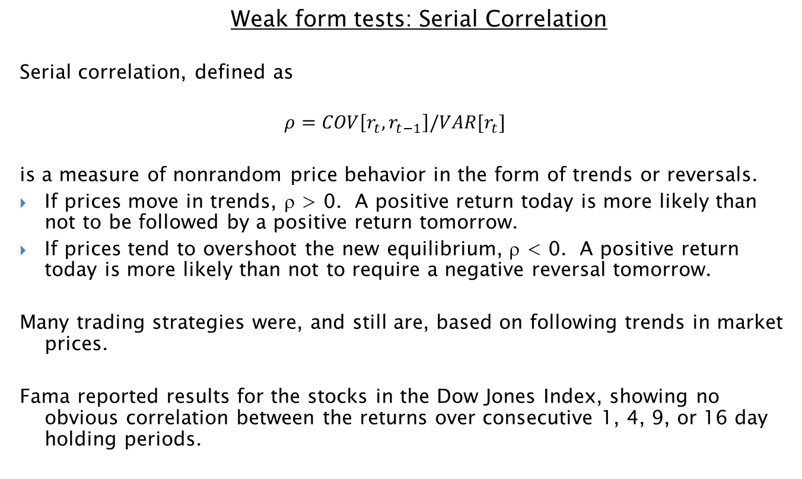
Fama Reports Statistical Evidence from Many Studies
  Weak form tests: Serial Correlation
Serial correlation, defined as
$$ρ=COV\left[r_{t},r_{t−1}\right]/VAR[r_{t}]$$
is a measure of nonrandom price behavior in the form of trends or reversals.
If prices move in trends, ρ > 0. A positive return today is more likely than not to be followed by a positive return tomorrow.
If prices tend to overshoot the new equilibrium, ρ < 0. A positive return today is more likely than not to require a negative reversal tomorrow.
Many trading strategies were, and still are, based on following trends in market prices.
Fama reported results for the stocks in the Dow Jones Index, showing no obvious correlation between the returns over consecutive 1, 4, 9, or 16 day holding periods.
FINC-GB.2349 Spring 2017
Trading Cash and Derivative Securities ©2017 Figlewski

Slide 12
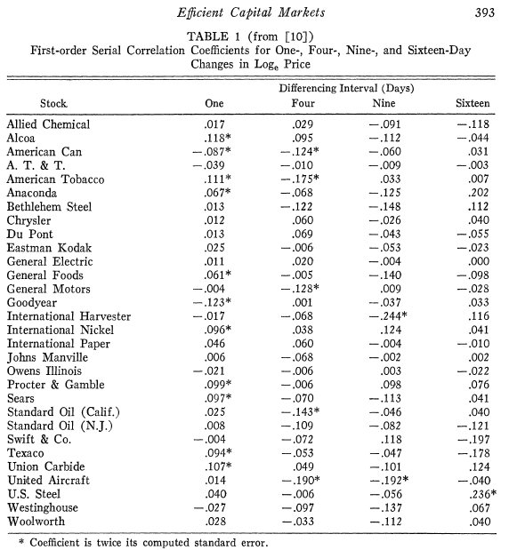

Slide 13
Fama Reports Statistical Evidence from Many Studies
  Weak form tests: Filter Rules
  Example: Buy when the price is 10% above its most recent low; sell after it reaches a peak and falls 10% below it
Alexander (1961, 1964) concluded that filter rules made excess returns. But his "trading strategy" turned out to be non-operational.
This is a common problem with seemingly great trading strategies:
Apparent profit opportunities in recorded prices are rarely there in reality, given transactions costs and other operational difficulties.
Top
Top – 10%
SELL
Bottom + 10%
BUY
Bottom
FINC-GB.2349 Spring 2017
Trading Cash and Derivative Securities ©2017 Figlewski

Slide 14
And yet...
Efficient Markets became the baseline for academic finance.
In 2013, Fama won the Nobel Prize for his work. It was an appropriate choice.
But there is a paradox with efficient markets:
  Grossman and Stiglitz ("The Impossibility of Informationally Efficient Markets," Journal of Finance,1980) If everyone believed the market price was fully efficient, there would be no point in doing research to develop information. But the market can't fully reflect information that no one has bothered to produce. There has to be a (fair) reward for research.
Constraints on trading can also interfere with information efficiency.
  (bans on short sales, prohibitions on holding certain types of assets by fiduciaries like pension funds, etc.)
Empirical research shows investors are, unfortunately, not fully rational. In fact, nowhere near rational.
FINC-GB.2349 Spring 2017
Trading Cash and Derivative Securities ©2017 Figlewski

Slide 15
Efficient Markets
Fama, Malkiel and others have a lot of evidence on market efficiency
Statistical analysis supports weak form efficiency
Event studies support semistrong form efficiency
Mutual fund studies even give some support to strong form efficiency
FINC-GB.2349 Spring 2017
Trading Cash and Derivative Securities ©2017 Figlewski

Slide 16
On the other hand...
Robert Shiller shared the 2013 Nobel Prize with Fama.
But Shiller's work calls Efficient Markets into question in several ways.
stock prices are much too volatile relative to fluctuations in fundamental values
"Irrational Exuberance" during the Internet bubble
more irrationality in the housing bubble
FINC-GB.2349 Spring 2017
Trading Cash and Derivative Securities ©2017 Figlewski

Slide 17
On the other hand...
The new field of "Behavioral Finance" began with Kahneman (Nobel Prize 2002) and Tversky
(Michael Lewis's new book, The Undoing Project, describes these two interesting characters.)
They started an avalanche of research results showing that real investors act predictably in numerous "irrational" ways.
overconfidence
loss aversion
difficulty dealing with small probabilities correctly
effects of mental accounting, framing, anchoring, representativeness, and many others
FINC-GB.2349 Spring 2017
Trading Cash and Derivative Securities ©2017 Figlewski

Slide 18
So are markets efficient or aren't they?
  As our baseline position, we believe the market price is "really quite" efficient.
  To depart from that baseline belief in trading, we should
  recognize that "the market" probably thinks we are wrong;
  have strong evidence that the market prices really are incorrect;
  and have good reasons why the market is wrong.
  Be very aware of the truth of the Wall Street saying: "The market can stay irrational a lot longer than you can stay solvent."
  The typical way failing trading strategies fail is by not taking full account of all risks.
FINC-GB.2349 Spring 2017
Trading Cash and Derivative Securities ©2017 Figlewski

Slide 19
"Efficiently Inefficient" Markets
Pederson's book captures very well the synthesis between efficient and inefficient financial markets that we believe describes the real world.
In an efficient market, there is no impact on prices (that you can trade on) from any information that is widely known, such as anything that can be extracted by analyzing past data.
In an inefficient market, anything goes. Prices may depart wildly and randomly from true economic value.
A real world financial market aggregates the supply and demand for risky securities from all investors.
Information that is widely known will be reflected in prices, but maybe not perfectly.
There is a reward in the form of expected trading profits to having or generating new information that the market does not fully reflect.
In full equilibrium, the market price properly reflects some but not all information and the reward to information production is a fair return on the skill and effort involved.
FINC-GB.2349 Spring 2017
Trading Cash and Derivative Securities ©2017 Figlewski

Slide 20
Key Questions about a Possible Trading Strategy
1. Does it make sense that it would work in a market made up of reasonably intelligent and informed investors?
    Do other investors have to be uninformed or stupid for it to work?
2. What's the chance that we're wrong?
    ...and how bad can we get hurt if prices move against us?
3. What else is wrong with it?
    How badly can our hedging strategy fail? Can we be sure of future funding?
4. On top of those things, what else could go wrong?
    Are we protected if our counterparties fail, or refuse to pay what they legally owe? What if they actively try to do us in?
5. If there's really nothing wrong with it, why isn't everyone already doing it?
What is the actual reason behind an apparent statistical relationship?
OK. If we have good answers for Q1-Q5, what can we learn from statistical exploration of past data?
FINC-GB.2349 Spring 2017
Trading Cash and Derivative Securities ©2017 Figlewski

Slide 21
GB.2349: Trading in Cash and Derivatives Securities – Spring 2016
Session 2:
Measuring return and risk
Arbitrage in Theory and Practice
FINC-GB.2349 Spring 2017
Trading Cash and Derivative Securities ©2017 Figlewski

Slide 22
Testing a Potential Strategy on Past Data
"Past performance does not guarantee future results"
- Disclaimer seen on virtually all investment products.
Widely ignored in practice.
But anyway...
How would the strategy have done in the past?
What statistics to look at?
What sample period? (not too long not too short)
Adjusting properly for risk
Adjusting properly for transactions costs and limits on trading
Regime shifts (random shocks, policy changes)
⇒ out of sample testing is essential
"Peso Problems" and "Black Swans" (major shocks that did not happen during the historical sample period)
FINC-GB.2349 Spring 2017
Trading Cash and Derivative Securities ©2017 Figlewski

Slide 23
Measuring Performance: Returns
Returns
Returns must include both capital gain/loss and net cash flows from dividends, coupon interest, plus carrying costs for physical commodities, etc.
Capital gain = g = S_{t} / S_{t-1} -1
Example: A stock goes from 100 to 103. g = 103/100 – 1 = 3.00 %
Dividend yield = y = D_{t} / S_{t-1}
Example: The stock pays a dividend of $1. y = 1/100 = 1.00%
Total return: Dividend plus capital gain = r_{t} = (S_{t} + D_{t}) / S_{t-1} -1 = 4.00%
This is the simple (not compounded) holding period (not annualized) return
FINC-GB.2349 Spring 2017
Trading Cash and Derivative Securities ©2017 Figlewski

Slide 24
Measuring Performance: Returns
To compare returns over holding periods of different length, annualize the return.
The stock goes from 100 to 103 in 3 months. Holding period return is 3.00%. There would be 4 holding period of this length in a year.
Simple interest: Multiply the holding period return by the number of periods in a year.
r_{annual} = r_{3month} x 4 = 12.00%
Compound interest: Raise (1 + r_{holding period}) to a power equal to the number of periods in a year.
r_{annual} = (1 + r_{3month})⁴ – 1 = 12.55%
Market practice is generally to use simple interest in annualizing returns from periods of less than a year.
FINC-GB.2349 Spring 2017
Trading Cash and Derivative Securities ©2017 Figlewski

Slide 25
Measuring Performance: Returns
Compounding
APR: Annual Percentage Rate. APR corresponds to simple interest. By law it must be stated explicitly for many loans and interest-bearing deposits.
To calculate holding period interest from a quoted APR, divide by the number of holding periods in a year.
r_{3month} = r_{APR} / 4
EAR: Effective Annual Rate. EAR corresponds to the total return including any compounding of interest from rolling over an investment at the APR for a whole year.
Effective Annual Rate for the case with quarterly compounding is
r_{EAR} = (1 + r_{APR} / 4)⁴ -1
Example: APR = 12.00%, EAR = 1.03⁴ – 1 = 12.55%
FINC-GB.2349 Spring 2017
Trading Cash and Derivative Securities ©2017 Figlewski

Slide 26
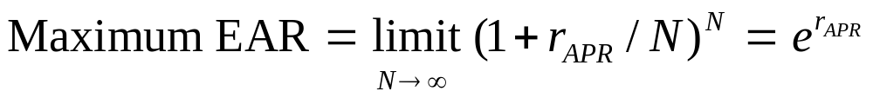
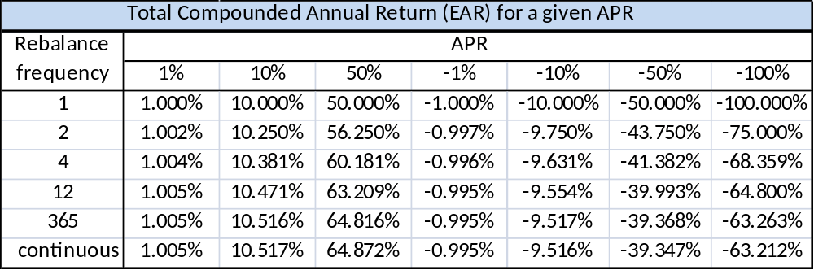
Measuring Performance: Returns
Compounding
Compounding a positive rate makes the annual return higher than the simple rate (EAR > APR). But there is an upper limit to the difference.
This is continuous compounding.
This table shows the total compounded annual return (EAR) for different rebalancing frequency and APR.

Slide 27
Measuring Performance: Returns
More issues with compounding
Convexity: The relationship between returns and the dollar value of an investment is nonlinear. If interest rates vary across time, the return over multiple periods will differ from the average return per period.
Suppose we have two periods, with r₁ and r₂ both equal to 10%. The two-period return is (1.10)(1.10) – 1 = 21.00%.
Instead if r₁ = 5% and r₂ = 15%, which averages 10%, the return over the two periods is (1+r₁)(1+r₂) = (1.05)(1.15) – 1 = 20.75%, 25 basis points lower.
The effect of dispersion in the rates lowers the effective average, due to convexity. The higher the variation in rates over the holding period, the larger the effect. This is a huge problem for leveraged ETFs.
Dispersion caused by volatility in returns produces a "convexity effect" in the expected value of future return: The higher the volatility, the lower the average expected return. Adjusting for this when the return probability distribution is Normal involves subtracting VAR[r]/2 from the E[r].
FINC-GB.2349 Spring 2017
Trading Cash and Derivative Securities ©2017 Figlewski

Slide 28
Log returns
With continuous compounding at a fixed rate per period r, over (T-t) periods, from date t to a later date T, the price grows from S_{t} to S_{T} like this:
S_{T} = S_{t} e^{r(T-t)}
The total log return is
Total return = log(S_{T} / S_{t})
= log(e^{r(T-t)})
= r(T-t)
Note that the log( ) function here is the "natural" log (base e = 2.7183, LN( ) in Excel).
Dividing the total return by the length of the time period gives the rate per period, which is r. With continuous compounding, r is the APR and the EAR is (e^{r} – 1)
Academic finance theory has adopted continuous-time for modeling asset returns, due to its realism and the major mathematical simplifications it permits, especially for option models.
S_{t} = 100, S_{T} = 130
100 e^{r x 3} = 130
3 r = log(130/100) = .2624
r = 8.75%
FINC-GB.2349 Spring 2017
Trading Cash and Derivative Securities ©2017 Figlewski

Slide 29


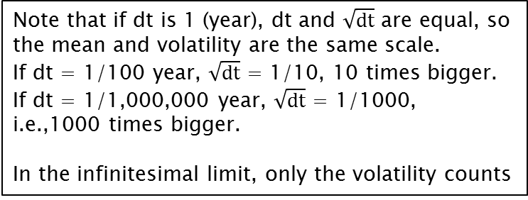
The Classic Returns Process
Black, Scholes and Merton introduced the lognormal diffusion.
dS = change in stock price over next instant (dt)
μ = drift (annualized mean return)
σ = volatility (annualized standard deviation of return)
dz = Brownian motion.
Each infinitesimal shock dz_{t} is a random variable independent of every other
dz_{s} , with
E[dz] = 0;
Variance[dz] = 1dt;
Standard deviation =
tiny independent
random shocks
that hit the system
continuously
annual capital
gains rate,
e.g. µ=0.06
% change in
stock price
annual volatility
e.g. σ=0.25
Note that if dt is 1 (year), dt and $\sqrt{dt}$ are equal, so
the mean and volatility are the same scale.
If dt = 1/100 year, $\sqrt{dt}$ = 1/10, 10 times bigger.
If dt = 1/1,000,000 year, $\sqrt{dt}$ = 1/1000,
i.e.,1000 times bigger.
In the infinitesimal limit, only the volatility counts
$$1\sqrt{dt}$$
FINC-GB.2349 Spring 2017
Trading Cash and Derivative Securities ©2017 Figlewski

Slide 30

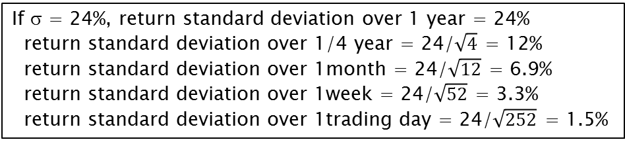
The Classic Returns Process
Key properties of the lognormal diffusion:
Returns are uncorrelated over time.
Process is continuous – no jumps
Return over T periods = Tμ
"Square Root of T" Rule for volatility:
  standard deviation of T period return =
If (continuously compounded)
mean µ = 10%,
2 year mean return = 20%;
1 day mean = 10/252 = 0.039%
If σ = 24%, return standard deviation over 1 year = 24%
return standard deviation over 1/4 year = 24/$\sqrt{4}$ = 12%
return standard deviation over 1month = 24/$\sqrt{12}$ = 6.9%
return standard deviation over 1week = 24/$\sqrt{52}$ = 3.3%
return standard deviation over 1trading day = 24/$\sqrt{252}$ = 1.5%
FINC-GB.2349 Spring 2017
Trading Cash and Derivative Securities ©2017 Figlewski

Slide 31
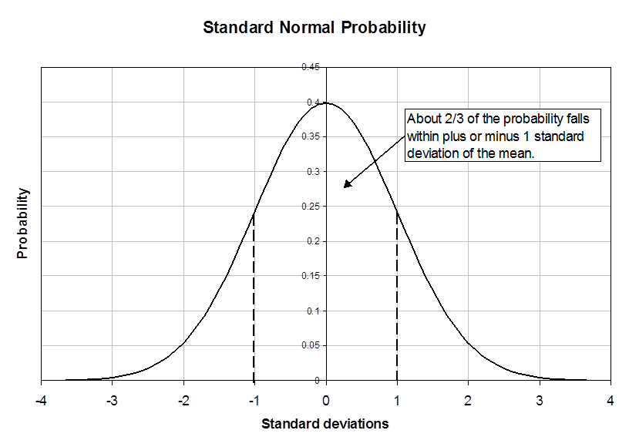
The Classic Returns Process: Returns
FINC-GB.2349 Spring 2017
Trading Cash and Derivative Securities ©2017 Figlewski

Slide 32
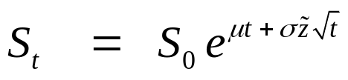

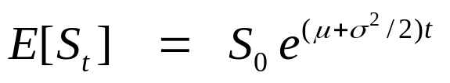
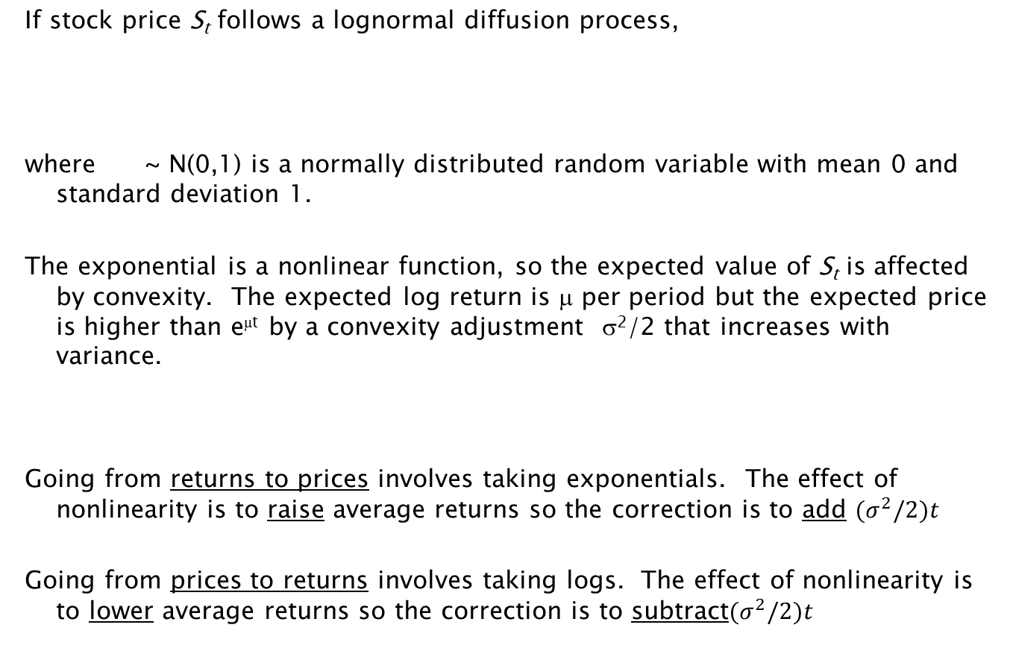
The Classic Returns Process
If stock price S_{t} follows a lognormal diffusion process,
where ~ N(0,1) is a normally distributed random variable with mean 0 and standard deviation 1.
The exponential is a nonlinear function, so the expected value of S_{t} is affected by convexity. The expected log return is μ per period but the expected price is higher than e^{μt} by a convexity adjustment σ²/2 that increases with variance.
Going from returns to prices involves taking exponentials. The effect of nonlinearity is to raise average returns so the correction is to add $(σ^{2}/2)t$
Going from prices to returns involves taking logs. The effect of nonlinearity is to lower average returns so the correction is to subtract$(σ^{2}/2)t$
FINC-GB.2349 Spring 2017
Trading Cash and Derivative Securities ©2017 Figlewski

Slide 33
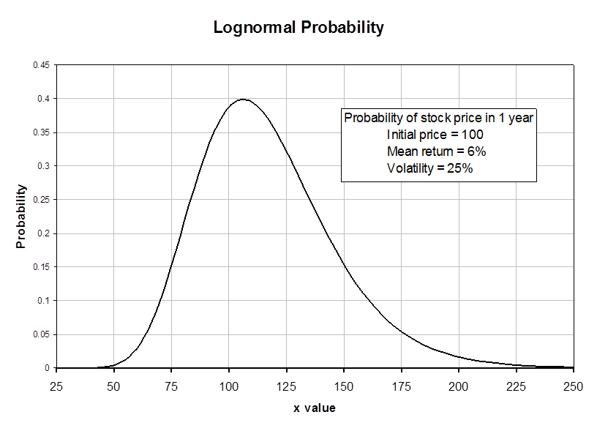
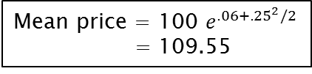
The Classic Returns Process: Prices
Mean price = 100 $e^{.06+{.25}^{2}/2}$
= 109.55
FINC-GB.2349 Spring 2017
Trading Cash and Derivative Securities ©2017 Figlewski

Slide 34
Estimating the mean from past data
"Past performance does not guarantee future results"
SERIOUSLY!
The sample mean is a terrible estimate of the true mean. This is a matter of mathematics, not finance.
Suppose you have a stock's price for every day over a full year and you want to estimate the mean of the returns process μ.
Step 1: Throw out all your data except the first price and the last price.
FINC-GB.2349 Spring 2017
Trading Cash and Derivative Securities ©2017 Figlewski

Slide 35
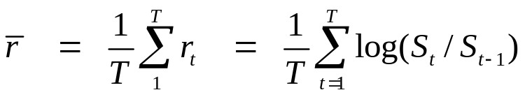
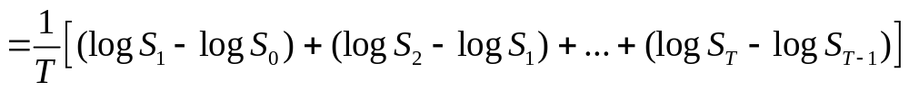
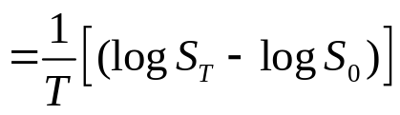
Estimating the mean from past data is terrible
True values:
Annual Mean: μ
Daily Mean: μ / T
Annual Volatility: σ
Annual Variance: σ²
Daily Variance: σ² / T
Log returns: r_{t} = log(S_{t}/S_{t-1}) = log(S_{t}) - log(S_{t-1})
Sample mean daily return:
μ = 0.10
μ / T = 0.10/255 = .000392
σ = 0.25
σ² = 0.0625
σ² / T = 0.000245
FINC-GB.2349 Spring 2017
Trading Cash and Derivative Securities ©2017 Figlewski

Slide 36
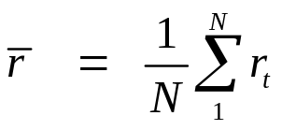
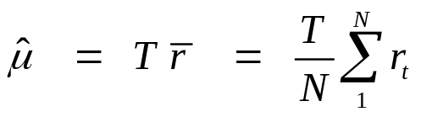
Estimating the mean from past data is terrible
Suppose we have returns from an N-day historical sample.
Sample mean daily return:
Estimate of Annual Mean
(T trading days in a year):
How good is this as an estimate of the true annual mean μ ?
Take a guess: Suppose annual stock volatility is 25% and the true mean is 10%.
  What is the 2 standard deviation 95% confidence interval around the sample mean return from the last 6 months? The true mean has a 95% chance of being in this interval (and 5% chance of being outside it).
  How about over the past 4 years of returns?
FINC-GB.2349 Spring 2017
Trading Cash and Derivative Securities ©2017 Figlewski

Slide 37

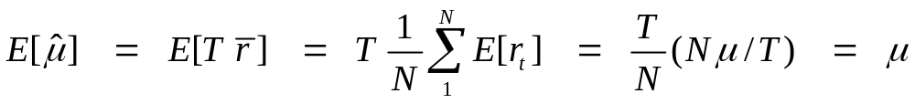

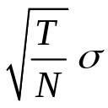
Proof: Estimating the mean from past data is terrible
as an estimate of the true annual mean μ :
1. The sample mean is an unbiased estimate of the true mean:
2. The variance of the forecast error is:
3. The standard error on as an estimate of μ :
=> The standard error on the estimated mean is the annual volatility divided by the square root of the number of years in the sample.
FINC-GB.2349 Spring 2017
Trading Cash and Derivative Securities ©2017 Figlewski

Slide 38
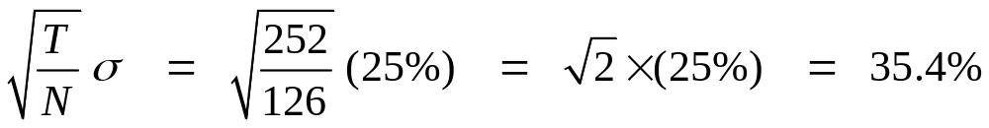
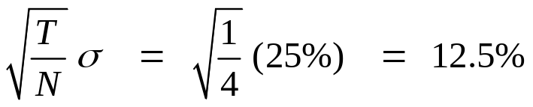
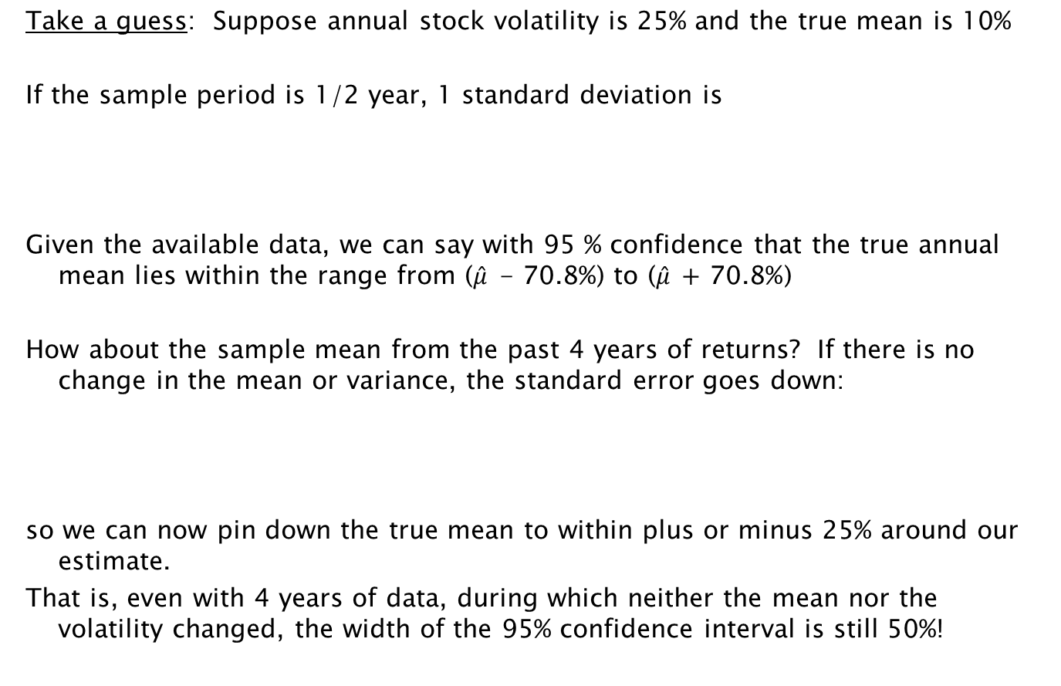
Estimating the mean from past data
Take a guess: Suppose annual stock volatility is 25% and the true mean is 10%
If the sample period is 1/2 year, 1 standard deviation is
Given the available data, we can say with 95 % confidence that the true annual mean lies within the range from ($\hat{μ} \text{−} \text{70.8\%}$) to ($\hat{μ} \text{+}\text{ 70.8\%}$)
How about the sample mean from the past 4 years of returns? If there is no change in the mean or variance, the standard error goes down:
so we can now pin down the true mean to within plus or minus 25% around our estimate.
That is, even with 4 years of data, during which neither the mean nor the volatility changed, the width of the 95% confidence interval is still 50%!
FINC-GB.2349 Spring 2017
Trading Cash and Derivative Securities ©2017 Figlewski

Slide 39
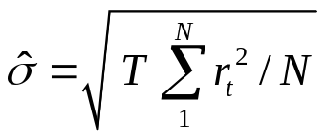
Estimating the mean from past data
What should we conclude from this?
1. This problem is a matter of math, not modeling. It is because returns are independent over time. There is no way around it.
2. Don't take deviations from the sample mean in estimating volatility and correlation from daily data. Assume the mean is zero, which will normally be a lot closer than the sample average is to the truth.
Estimate volatility as
3. It bears repeating: "Past performance does not guarantee future results"
  Any reported results based on past mean returns need to be questioned.
4. Luckily, this is only a problem for the mean. Higher moments like variance, volatility, correlation, skewness, and kurtosis are all OK. For all of those, you get more accuracy the finer you divide the sample period. Daily data is a lot better than weekly data for estimating volatility, for example.
FINC-GB.2349 Spring 2017
Trading Cash and Derivative Securities ©2017 Figlewski

Slide 40
Backtesting a Potential Trading Strategy
The objective is to use past data to find a method of predicting future return and risk. We hope that what worked in the past will continue to work in the future. Note that whether a method is good is inherently tied to forecasting.
There is a crucial difference between in-sample and out-of-sample testing.
Pedersen, Ch. 3 gives an excellent summary of what is involved in doing backtesting correctly.
Several problems that need to be handled properly (i.e., as well as you can).
time lags: Trades can't be made before necessary input data is available.
  closing prices, accounting and macroeconomic data, time zone diffs, ...)
transactions costs:
  commissions, bid-ask spreads, market impact of large trades
data mining: "All backtests suffer from data mining bias." (Pedersen, p. 49)
  How do you pick a strategy to look at?
  How do you pick the correct way to implement the strategy?
  What time period is relevant? What is the best amount of "history" to look at?
  How many alternatives/tweaks to the procedure were considered?
  How fast does the system evolve? Will the future resemble the past?
FINC-GB.2349 Spring 2017
Trading Cash and Derivative Securities ©2017 Figlewski

Slide 41
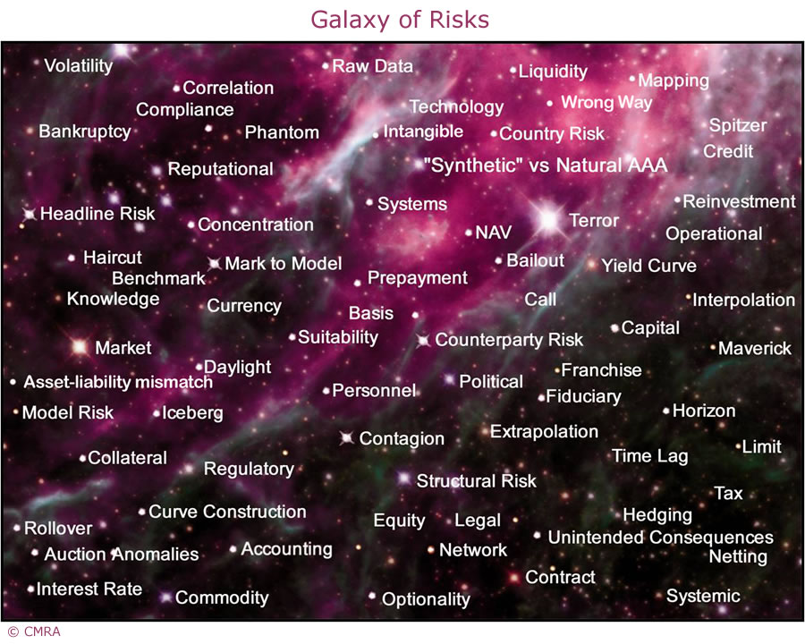
The Galaxy of Risks
from Capital Market Risk Advisers

Slide 42
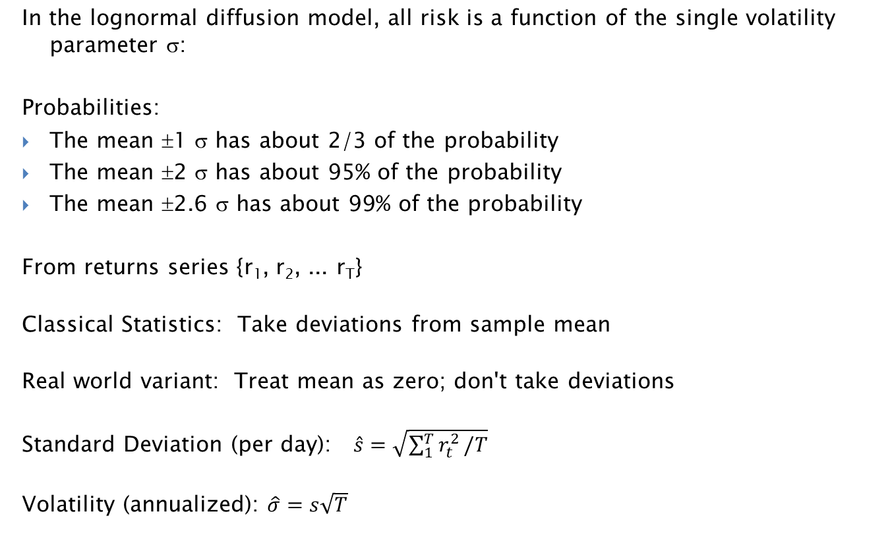
Risk Measures: Standard Deviation
In the lognormal diffusion model, all risk is a function of the single volatility parameter σ:
Probabilities:
The mean ±1 σ has about 2/3 of the probability
The mean ±2 σ has about 95% of the probability
The mean ±2.6 σ has about 99% of the probability
From returns series {r₁, r₂, ... r_{T}}
Classical Statistics: Take deviations from sample mean
Real world variant: Treat mean as zero; don't take deviations
Standard Deviation (per day): $\hat{s}=\sqrt{\sum_{1}^{T}{r_{t}^{2}}/T}$
Volatility (annualized): $\hat{σ}=s\sqrt{T}$
FINC-GB.2349 Spring 2017
Trading Cash and Derivative Securities ©2017 Figlewski

Slide 43
Square Root of T Rule Example
The "square root of T" Rule describes how risk (standard deviation, volatility) behaves in a market with independent returns.
Example: Suppose the annual return volatility for the Dow Jones Index is 20%. On a particular day, the index falls 200 points from 16000 to 15,800.
How bad a day was it?
How bad would a 5% probability event be?
How bad is a 1% probability event?
FINC-GB.2349 Spring 2017
Trading Cash and Derivative Securities ©2017 Figlewski

Slide 44
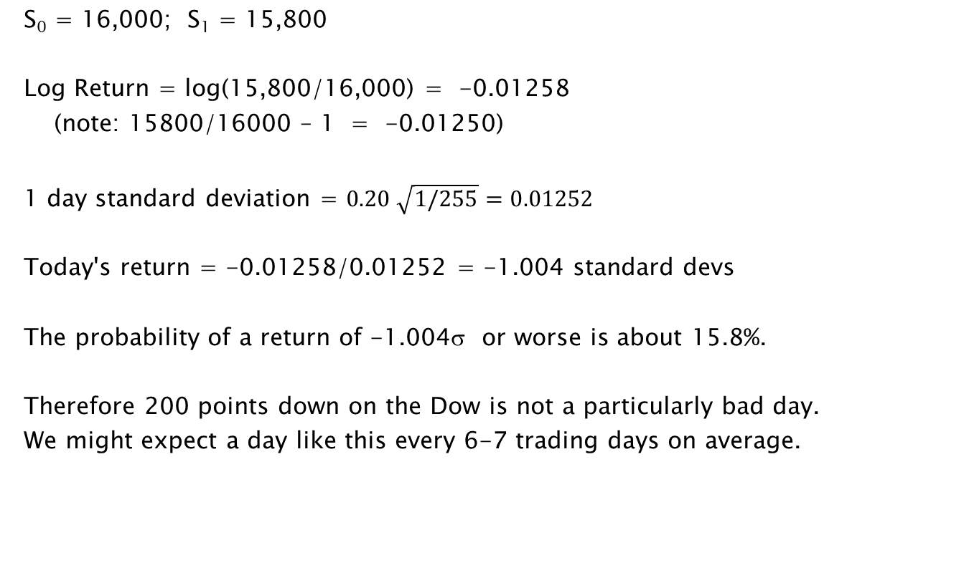
Square Root of T Rule Example
S₀ = 16,000; S₁ = 15,800
Log Return = log(15,800/16,000) = -0.01258
(note: 15800/16000 – 1 = -0.01250)
1 day standard deviation = $0.20 \sqrt{1/255}=0.01252$
Today's return = -0.01258/0.01252 = -1.004 standard devs
The probability of a return of -1.004σ or worse is about 15.8%.
Therefore 200 points down on the Dow is not a particularly bad day.
We might expect a day like this every 6-7 trading days on average.
FINC-GB.2349 Spring 2017
Trading Cash and Derivative Securities ©2017 Figlewski

Slide 45
How Bad is Bad?
S₀ = 16,000; 1-day standard deviation = 0.01252
How bad would it have to be to be a 5% probability event?
5% probability for the normal = -1.645 std devs
= -1.645 x 0.01252
= -0.0206
S_{5% prob loss} = S₀ e^{-0.0206} = 16000 x 0.9796 = 15674, i.e., -326 Dow points.
How bad would it have to be to be a 1% probability event?
1% probability for the normal = -2.326 std devs
= - 2.326 x 0.01252
= -0.0291
S_{1% prob loss} = S₀ e^{-0.0291} = 16000 x 0.9713 = 15541, i.e., -459 Dow points.
FINC-GB.2349 Spring 2017
Trading Cash and Derivative Securities ©2017 Figlewski

Slide 46
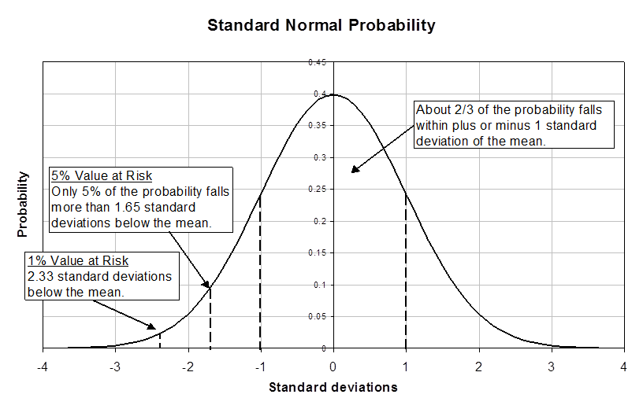
Value at Risk: A bad risk measure, but everyone uses it
FINC-GB.2349 Spring 2017
Trading Cash and Derivative Securities ©2017 Figlewski

Slide 47
Value at Risk: A bad risk measure, but everyone uses it
This calculation of the cutoff in the left tail corresponding to a given probability is the Value at Risk (VaR)
VaR is widely used as a risk measure, including for setting risk limits for traders
VaR has plenty of shortcomings
Loss distribution must be Normal (or whatever is assumed by the user)
You have to forecast the volatility
No account of how bad a loss in the tail might be
Assumption that risk exposure is linear (-2 std devs is twice as bad as -1), which is untrue if options are involved
Mathematician's Lament: VaR is not subadditive
Possibility of gaming the system (hiding a trader's true risk exposure)
Expected shortfall is a much better measure (but not as easy to calculate).
ES = expected value of loss in the tail beyond the VaR cutoff.
FINC-GB.2349 Spring 2017
Trading Cash and Derivative Securities ©2017 Figlewski

Slide 48
Skewness and Fat Tails
The lognormal diffusion model, unfortunately, doesn't fully capture how real world returns behave.
Skewness: The distribution of returns tends to be left-skewed, not symmetrical: The market drops faster than it goes up.
Fat tails: For a given volatility σ, large price changes both positive and negative are more frequent than the normal distribution allows for.
  non-normal shocks
  time-varying volatility
  jumps
  parameters implied out from derivatives prices are risk-neutral values
  "Peso problems"
  "Black Swans"
Underappreciated tidbit: Tail fatness is often measured by kurtosis.
κ = E[ (X - µ)⁴ ]/σ⁴
κ = 3 for the normal distribution, so κ > 3 means fat tails. The problem is that this only works for a symmetrical distribution. If there is skewness, kurtosis doesn't necessarily mean both tails are fat.
FINC-GB.2349 Spring 2017
Trading Cash and Derivative Securities ©2017 Figlewski

Slide 49
Combining risk and return in measuring performance
Return and risk are both crucial in investment performance and strategies must be evaluated along both dimensions.
The most basic comparison is between the mean return on a risky asset and the risk free interest rate.
Excess return = r_{risky} - r_{f}
r_{risky} must include dividends and other cash flows
What is the appropriate riskless rate r_{f}?
FINC-GB.2349 Spring 2017
Trading Cash and Derivative Securities ©2017 Figlewski

Slide 50
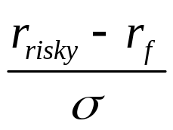
Combining risk and return in measuring performance
The excess return over the riskless rate doesn't distinguish among assets with different risk exposures.
The most common measure that takes both risk and return into account is the Sharpe ratio.
Sharpe ratio:
The Sharpe ratio is meant to measure how much extra return the risky security earns per unit of risk exposure.
The Sharpe ratio is very commonly used, but it doesn't take account of the possible diversification effects of adding the security to a portfolio.
FINC-GB.2349 Spring 2017
Trading Cash and Derivative Securities ©2017 Figlewski

Slide 51
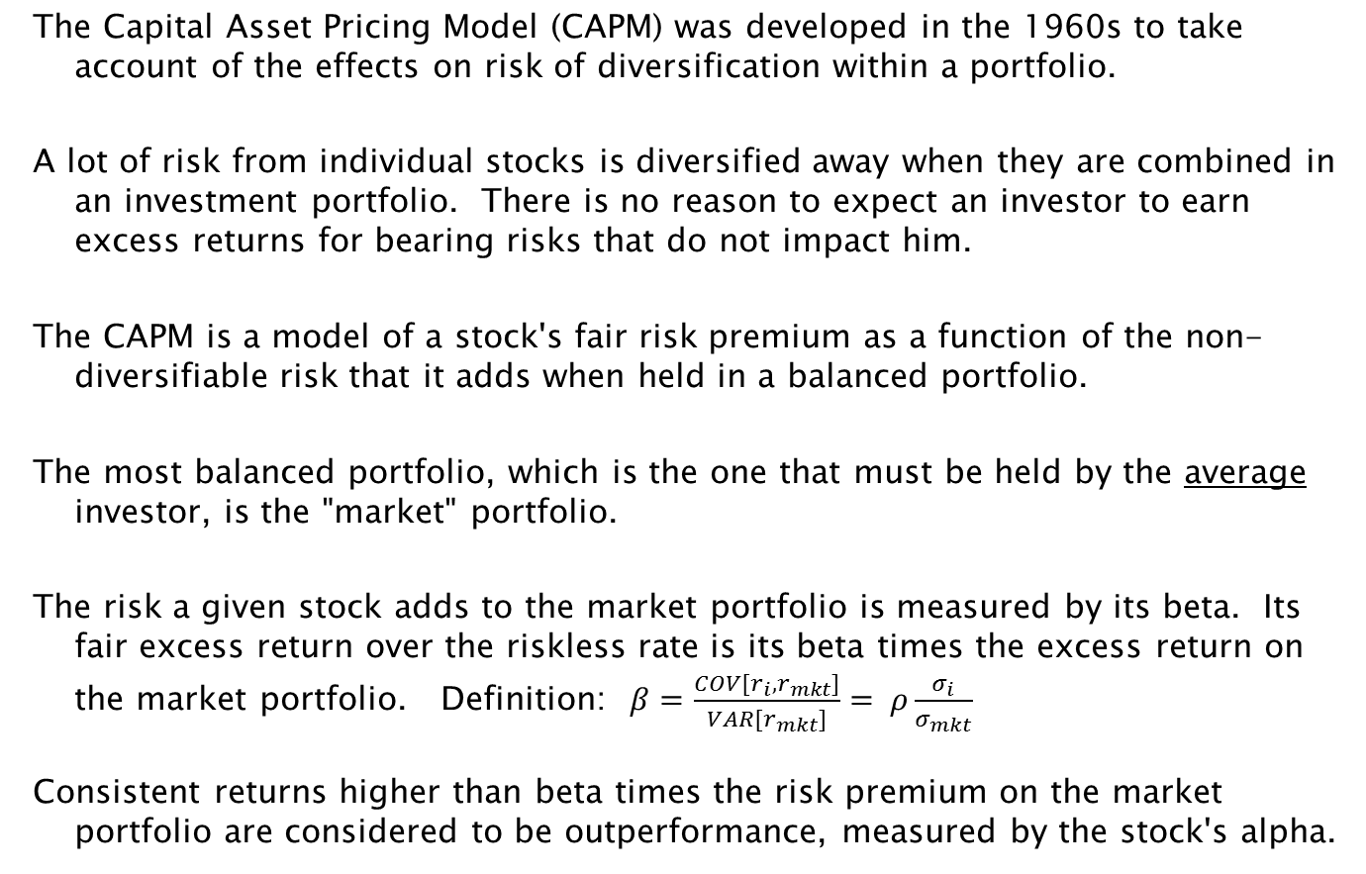
Combining risk and return in measuring performance
The Capital Asset Pricing Model (CAPM) was developed in the 1960s to take account of the effects on risk of diversification within a portfolio.
A lot of risk from individual stocks is diversified away when they are combined in an investment portfolio. There is no reason to expect an investor to earn excess returns for bearing risks that do not impact him.
The CAPM is a model of a stock's fair risk premium as a function of the non-diversifiable risk that it adds when held in a balanced portfolio.
The most balanced portfolio, which is the one that must be held by the average investor, is the "market" portfolio.
The risk a given stock adds to the market portfolio is measured by its beta. Its fair excess return over the riskless rate is its beta times the excess return on the market portfolio. Definition: $β=\frac{COV[r_{i},r_{mkt}]}{VAR[r_{mkt}]}= ρ\frac{σ_{i}}{σ_{mkt}}$
Consistent returns higher than beta times the risk premium on the market portfolio are considered to be outperformance, measured by the stock's alpha.
FINC-GB.2349 Spring 2017
Trading Cash and Derivative Securities ©2017 Figlewski

Slide 52
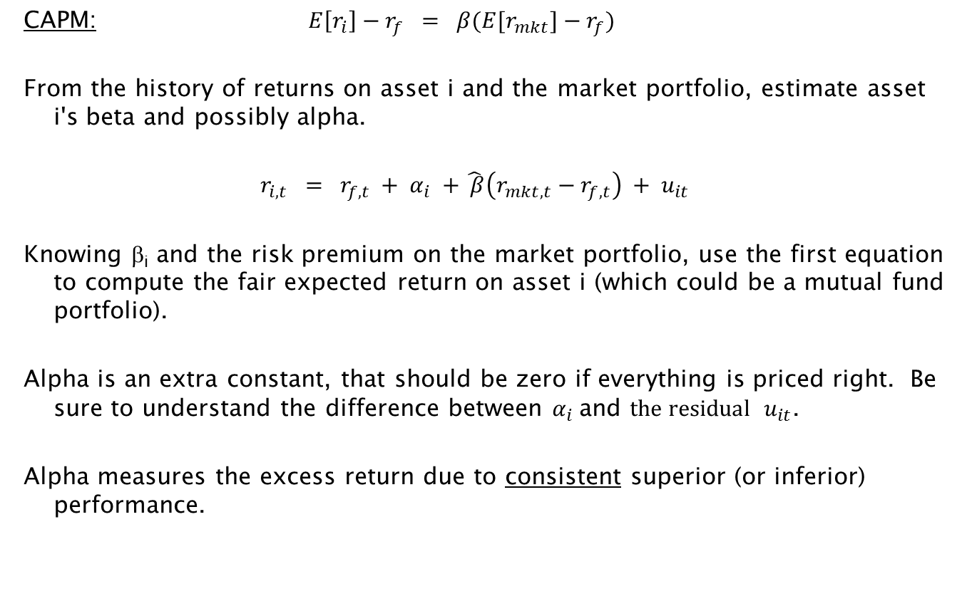
CAPM Alpha as the Performance Measure
FINC-GB.2349 Spring 2017
Trading Cash and Derivative Securities ©2017 Figlewski

Slide 53
CAPM Alpha as the Performance Measure
E[r]
•
alpha
E[r_{mkt}]
r_{f}
β=1
beta
FINC-GB.2349 Spring 2017
Trading Cash and Derivative Securities ©2017 Figlewski

Slide 54
Fama Reports Statistical Evidence from Many Studies
  Semi-strong form tests: Event Studies
  The Capital Asset Pricing Model was a new thing when Fama wrote his article and was first being used to test trading strategies.
  "The article that launched a thousand dissertations"
  Fama, Fisher, Jensen, and Roll (1969) developed the event study, a classic test of market efficiency.
  They tested whether a stock split contained information about future returns and when that information was fully impounded in the stock price.
  The Cumulative Average Residual, CAR(t), is the sum of the u_{i,t} over time, from date 0 to t. CAR(t) on stocks for dates around the split date showed the following classic pattern that most event studies produce:
FINC-GB.2349 Spring 2017
Trading Cash and Derivative Securities ©2017 Figlewski

Slide 55
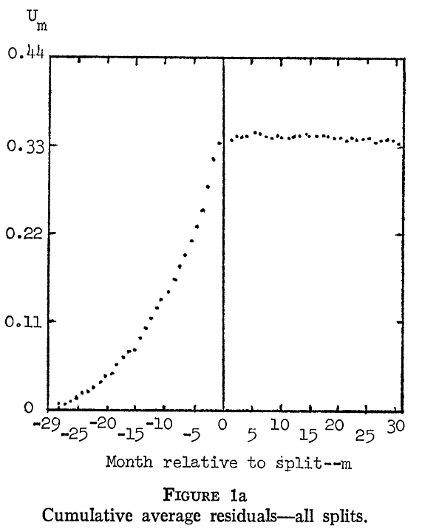
from Fama, Fisher, Jensen and Roll (1969)
FINC-GB.2349 Spring 2017
Trading Cash and Derivative Securities ©2017 Figlewski

Slide 56
Fama Reports Statistical Evidence from Many Studies
  Strong form tests: Mutual Funds Studies
  No one believes the market is strong-form efficient. If it were, there would be no need for rules prohibiting insider trading.
  Jensen (1968) tested how much excess return professional mutual fund managers earned from their superior information relative to a passive combination of the riskless asset and the market portfolio with the same beta.
  For 115 funds over 10 years,
  Including load fees, returns averaged -14.6% below the passive strategy and 89 funds underperformed.
  Adding back the load fees still left an average -8.9% and 72 funds underperforming.
  Adding back all fees (to measure stock picking ability independent of costs) left about half underperforming and average performance just equal to the passive strategy.
FINC-GB.2349 Spring 2017
Trading Cash and Derivative Securities ©2017 Figlewski

Slide 57
CAPM Alpha as the Performance Measure
Issues with using alpha as the performance measure
Alpha measures performance relative to the stock market portfolio, not relative to the individual's actual investment portfolio.
Return must include dividends.
  Because dividend yield and the riskless rate are quite small in daily data, they are often left out in estimating beta.
Beta can be estimated fairly accurately, but the market doesn't deliver the risk premium for beta risk (more on this in a later class).
What is the market portfolio? What is the riskless rate?
Is past alpha persistent. Maybe it is just a previously underpriced asset coming into line.
The model is a theory of expected returns. What is the correct price?
FINC-GB.2349 Spring 2017
Trading Cash and Derivative Securities ©2017 Figlewski

Slide 58
Measuring Performance: Beyond the CAPM
Original CAPM:
Fama and French ("Common risk factors in the returns on bonds and stocks." JFE, 1993) developed an extended Capital Asset Pricing Model, with two extra factors:
  SMB: "small minus big" – the difference between the returns on small cap stocks and large cap stocks
  HML: "high minus low" ratio of book to market value of equity
Fama-French 3-factor model:
Carhart ("On persistence in mutual fund performance." JFin, 1997) added another factor to capture the effect of year-to-year momentum in returns (average of highest 30% last year returns minus average of lowest 30% )
Carhart 4-factor model:
FINC-GB.2349 Spring 2017
Trading Cash and Derivative Securities ©2017 Figlewski

Slide 59
Arbitrage
One of most misused terms in finance
True arbitrage requires three things:
1. Buying something and selling essentially the same thing in a different way
2. Doing the trades simultaneously
3. To create a risk free position.
The abuse of the term generally involves calling a risky trade an arbitrage. Academic economists may even use the term for trades with an expected profit that are made by an "informed" trader. Trading on information is risky, so it is actually speculation.
Of course, in the Real World, nothing is ever riskless. A key distinction is whether the trade in question should be risk free in theory, even if isn't in practice. Stock index futures arbitrage is arbitrage; equity long-short strategies aren't arbitrage.
FINC-GB.2349 Spring 2017
Trading Cash and Derivative Securities ©2017 Figlewski

Slide 60
Arbitrage
Arbitrage is at the heart of all derivatives pricing models
A derivative is priced relative to its underlying by arbitrage
An acceptable model for trading should be "arbitrage-free" (meaning no arbitrage trades are profitable at current market prices)
Arbitrage-based theoretical models are consistent with "risk neutral valuation." [So what?]
But this only leads to "Ketchup economics" according to Larry Summers
the "no-arbitrage" condition values one thing relative to another without pinning the price of either down to a single true value
Many trading strategies are based on arbitrage or near-arbitrage, which allows much better risk management
convergence trades
convertible bond arbitrage
pairs trading
"risk arbitrage" (UGH! A contradiction in terms!)
FINC-GB.2349 Spring 2017
Trading Cash and Derivative Securities ©2017 Figlewski

Slide 61
Arbitrage
In a theoretical model, arbitrage is a powerful concept with strong implications for market prices.
The "no-arbitrage" principle is that when prices are in equilibrium in a frictionless market, there will no opportunities to make a risk free excess return by arbitrage.
In the real world, arbitrage is a trade with risks and transactions costs that impose limits on how far it will be pursued.
How strong the theoretical pricing implications derived from no-arbitrage are in a particular real world market will depend on how easy or hard it is to do the actual arbitrage trade in that market.
If you can't do the trade in practice, there is no reason to expect an arbitrage-based theoretical model to capture real world pricing. (Academic researchers typically fail to think about this.)
FINC-GB.2349 Spring 2017
Trading Cash and Derivative Securities ©2017 Figlewski

Slide 62
Arbitrage Examples
Locked Arb:
silver certificates – could be redeemed in silver bullion until June 24, 1968 (when the amount of silver received was worth $1.29)
market maker with both sides of the trade lined up
Figlewski in the index options pit
Real world true arbitrage:
John Meriwether and the T-bill trade
covered interest arbitrage in FX
stock index futures
FINC-GB.2349 Spring 2017
Trading Cash and Derivative Securities ©2017 Figlewski

Slide 63
Arbitrage in FX
Suppose we have the following data about interest rates and exchange rates for the US and the UK:
  US interest rate: 5%
  UK interest rate: 10%
  Spot exchange rate: £ 1.00 = $2.00
  1-Year Forward rate: £ 1.00 = $2.10
What is your trade?
FINC-GB.2349 Spring 2017
Trading Cash and Derivative Securities ©2017 Figlewski

Slide 64
Arbitrage in FX
Invest $100 in two different ways:
US
UK
Put $100
in US bank
at 5%
Exchange
$100 for £;
sell £ forward
Put £50 in
UK bank
at 10%
convert to £50
Today
at same time lock in $2.10
forward rate
Receive
$105
in 1 year
Receive
$115.50
Receive £55
in 1 year
1 Year
convert £55
at $2.10/£
FINC-GB.2349 Spring 2017
Trading Cash and Derivative Securities ©2017 Figlewski

Slide 65
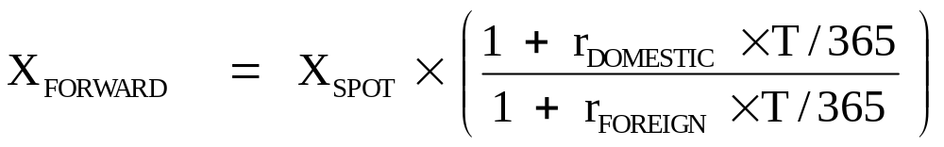
Covered Interest Parity for FX Forward Rate
There will be arbitrage trading as long as the two ways to invest $ lead to different amounts in 1 year.
Equilibrium requires, for a holding period of d years (d is called the "accrual factor")
$100 (1 + r_{US} x d) = ($100/X_{spot}) x (1 + r_{UK} x d) x X_{forward}
Solving for the equilibrium forward exchange rate:
Covered interest parity:
FINC-GB.2349 Spring 2017
Trading Cash and Derivative Securities ©2017 Figlewski

Slide 66
Extracting the Market's Forecasts from Futures Prices
A futures market allows investors to make bets based on their price expectations. These predictions are aggregated and reflected in the futures price.
Wouldn't it be great if we could just look at the futures market and get the best available prediction of the price in the future?
How Should the Futures Price be Related to the Price of Its Underlying?
There are two well established theories of futures pricing in equilibrium:
Explanation #1: The Expectations Model
Explanation #2: The Cost of Carry Model
Key questions:
Which one applies in each given case?
How do expectations get into prices in the cost of carry model?
How do risk preferences get into prices in both models?
FINC-GB.2349 Spring 2017
Trading Cash and Derivative Securities ©2017 Figlewski

Slide 67
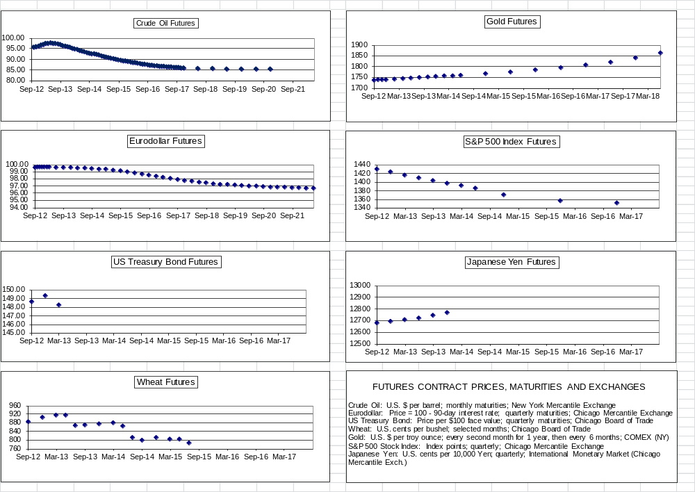
Futures Prices: Expectations vs Arbitrage

Slide 68
Futures Prices: Expectations vs Arbitrage
Explanation #1: The Expectations Model
The reasoning: If futures are trading at a price F,
any trader who expects the price at expiration S_{T} > F will buy futures
any trader who expects S_{T} < F will sell futures
the equilibrium futures price will be the market's average forecast for S_{T}
about half the traders will be long futures and half will be short.
The result: The futures price will the market's expected value for the price of the underlying asset on the expiration date of the futures contract.
Is the Expectations Model the right one for stock index futures?
FINC-GB.2349 Spring 2017
Trading Cash and Derivative Securities ©2017 Figlewski

Slide 69
Futures Prices: Expectations vs Arbitrage
Let's Check Out the Expectations Model on S&P 500 Futures
If the futures price for the Standard and Poor's 500 Stock Index is the market's forecast of the S&P 500 index on the futures expiration date, what should the futures price be?
Current Market Data
    Today's date Feb. 7, 2017
    S&P 500 index level 2293.08
    Average annual dividend yield 1.98%
    Interest rate (3 month LIBOR) 1.04%
    Expected risk premium
    on equities 4.0% ?
    Futures contracts
      MAR 2017 (38 days)
      JUN 2017 (129 days)
      SEP 2017 (220 days)
FINC-GB.2349 Spring 2017
Trading Cash and Derivative Securities ©2017 Figlewski

Slide 70
Futures Prices: Expectations vs Arbitrage
Leaving futures aside, let's calculate the
Market's Expected Value for the S&P 500 Index at Futures Expiration
The total return on the S&P index = capital gain + dividends
The equilibrium expected total return should equal the riskless interest rate plus a risk premium. In recent years, the expected equity risk premium is thought to be about 4%.
Expected (capital gain + dividends) = (r_{f} + 4%) for T days until futures expiration
E[ S_{T} ] = S₀ x (1 + (r_{f} + 4.0% - dividend yield) x T/365 )
MAR 2017 S&P 500 Futures on Feb. 7, 2017:
E[S_{T} ] = 2293.08 x (1 + (1.04% + 4.00% - 1.98%) x 38/365 )
= 2300.39 Is this where the MAR future was trading?
FINC-GB.2349 Spring 2017
Trading Cash and Derivative Securities ©2017 Figlewski

Slide 71
Stock Index Futures Prices: The Expectations Model?
No!
Futures contract | Expected Index at Expiration | Closing Prices in Futures Market
MARCH 2017 | 2300.39 | 2288.00
JUNE 2017 | 2317.88 | 2283.10
SEPTEMBER 2017 | 2335.37 | 2278.70
FINC-GB.2349 Spring 2017
Trading Cash and Derivative Securities ©2017 Figlewski

Slide 72
Futures Prices: Expectations vs Arbitrage
These futures prices are well below where the market expects the index to be on these three expiration dates.
What should be your trade?
FINC-GB.2349 Spring 2017
Trading Cash and Derivative Securities ©2017 Figlewski

Slide 73
Futures Prices: Expectations vs Arbitrage
Question:
Alternatively, suppose the market futures prices were the values we computed for the expected index level at futures expiration, e.g., MAR futures price = 2300.39.
What should be your trade in that case?
FINC-GB.2349 Spring 2017
Trading Cash and Derivative Securities ©2017 Figlewski

Slide 74
Futures Prices: Expectations vs Arbitrage
The expected future level of the S&P Index includes a 4.0% risk premium.
If you could sell futures at the level the market expects for S_{T}, you would lock in the market's expected return including the risk premium, but with no risk.
The market riskless rate is only r_{f}, = 1.04%.
  borrow money at 1.04%
  buy stocks at S₀ = 2293.08
  sell futures at F = E[S_{T}] = 2300.39.
  collect 4.0% excess return
This riskless position can't be an equilibrium.
To eliminate the excess profit from the "cash and carry" arbitrage, the futures price must be at a level that locks in the same return 1.04% as on any other riskless position.
The resulting model for futures prices, based on arbitrage, is called the
"Cost of Carry" Model.
FINC-GB.2349 Spring 2017
Trading Cash and Derivative Securities ©2017 Figlewski

Slide 75
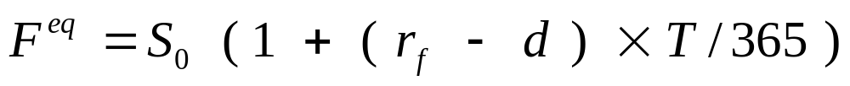
Cost of Carry Pricing for Stock Index Futures
The underlying asset for an index futures contract is the portfolio of stocks that compose the index.
The cost of buying the portfolio and carrying it to futures expiration date is:
1. the level of the index today
2. plus the cost of funding the position (at the riskless interest rate)
3. minus the dividend payout received, which reduces the net carrying cost
Let d = dividend yield, expressed as an annualized percentage rate
or more exact:
PV(D) = present value of future dividend payout, through
futures expiration, in index points
FINC-GB.2349 Spring 2017
Trading Cash and Derivative Securities ©2017 Figlewski

Slide 76
Cost of Carry Pricing for Stock Index Futures
Futures contract | Cost of Carry Value for Future | Closing Prices in Futures Market
MARCH 2017 | 2290.84 | 2288.00
JUNE 2017 | 2285.46 | 2283.10
SEPTEMBER 2017 | 2280.09 | 2278.70
It is obvious that the Cost of Carry model gives more accurate prices for stock index futures. (But why aren't they actually equal??)
FINC-GB.2349 Spring 2017
Trading Cash and Derivative Securities ©2017 Figlewski

Slide 77
Futures Prices: Expectations vs Arbitrage
The General Principle
If the arbitrage trade can be done, it will dominate pricing.
You have to be able to go long or short in the underlying and carry the position to futures expiration.
The futures price will be determined by the cost of carry relationship
If you can't do the arbitrage trade, futures prices will be based on supply and demand
from both speculators and hedgers
The futures price should be the expected future spot price plus or minus an appropriate risk premium. (More speculators => smaller premia and cheaper hedges)
Hard commodities and financial instruments will normally obey cost of carry.
Nonstorable things like interest rates, heating degree days or the CPI, as well as agricultural commodities that have a harvest before futures expiration will normally be priced based on expectations.
FINC-GB.2349 Spring 2017
Trading Cash and Derivative Securities ©2017 Figlewski

Slide 78
Futures Prices: Expectations vs Arbitrage
Where are the Expectations and the Risk Premia?
The market's price expectations are not in the cost of carry pricing relationship. Does this mean that the future price has nothing to do with expectations???
No! The market's prediction of where the spot price will be in the future is embedded in the current spot price in the market. The futures price is the spot price plus net carrying cost, so it reflects the same expectations. But you don't learn anything more from the futures price than you do from the spot price.
Cost of carry pricing does not directly depend on risk premia because an arbitrageur doesn't bear any risk. But the spot price for the underlying is affected by investors' risk aversion, so that is how risk premia get into the futures price.
In a market where the cost of carry model does not apply, the futures price does reflect the market's expectation about the futures spot price. (This is the "Expectations Model.")
Under the Expectations Model, the market price can be pushed away from the market's expected future spot price by hedgers trading on one side of the market. Selling futures to hedge a long position in the underlying pushes the futures price down, which imparts a risk premium to the long side of the contract. (This is called "normal backwardation.")
FINC-GB.2349 Spring 2017
Trading Cash and Derivative Securities ©2017 Figlewski

Slide 79
Futures Prices: Expectations vs Arbitrage
Which of the Above Futures Markets Follow Cost of Carry Pricing?
Which Ones are Determined by Expectations?
The underlyings for these futures markets can be easily bought today and carried to expiration:
  Gold
  Stock Index Portfolio
  Foreign Exchange (Japanese Yen)
  Treasury Bonds
These underlyings can't be carried over time:
  Short Term Interest Rates (Eurodollar rates)
  Heating/Cooling degree days
  the VIX index of implied volatility
These underlyings are somewhat ambiguous. They can be carried for short periods but not to expiration for all maturities.
  Crude Oil (short term storage is expensive; better to leave it in the ground for free)
  Wheat (storage is needed but only until the next harvest; more distant maturities are based on expectations)
FINC-GB.2349 Spring 2017
Trading Cash and Derivative Securities ©2017 Figlewski

Slide 80
The Stock Index Arbitrage Trade in Practice
Stock index futures were introduced in 1982. At first they were consistently underpriced.
Some eager finance professors published scholarly papers explaining why this was to be expected because of different tax treatment between futures and stocks.
Other finance professors felt those explanations were nonsense.
Things reversed. In October 1984, index futures became very overpriced relative to the cost of carry model. How could this be?
The Crash of 1987 was pretty exciting for index arbitrageurs, and led to new insights about the limits to option replication for researchers
By 1990, the index futures market had settled into a normal equilibrium for a mature market.
FINC-GB.2349 Spring 2017
Trading Cash and Derivative Securities ©2017 Figlewski

Slide 81
Early Discounts on Index Futures
 |  | Full sample 6/1/82 to12/20/82 | 1st Half 6/1/82 to 9/14/82 | 2nd Half 9/15/82 to 12/20/82
% Discount from Futures Fair Value | Mean | -0.18 | -0.26 | -0.11
 | Std dev | 1.02 | 1.11 | 0.92
Excess return to the cash and carry trade | Mean | -3.14 | -6.14 | -0.19
(annualized %) | Std dev | 12.89 | 15.16 | 9.37
from Figlewski. "Explaining the Early Discounts on Stock Index Futures:
The Case for Disequilibrium." Financial Analysts Journal, July-August 1984
What is the trade you should do?
FINC-GB.2349 Spring 2017
Trading Cash and Derivative Securities ©2017 Figlewski

Slide 82
Coming of Age for Index Futures Arbitrage
Fall 1984: Futures were grossly overpriced.
Large and long-lived arbitrage opportunity for the cash and carry trade
Fischer Black comments informally on the limits to arbitrage
What is the trade you should do?
FINC-GB.2349 Spring 2017
Trading Cash and Derivative Securities ©2017 Figlewski

Slide 83
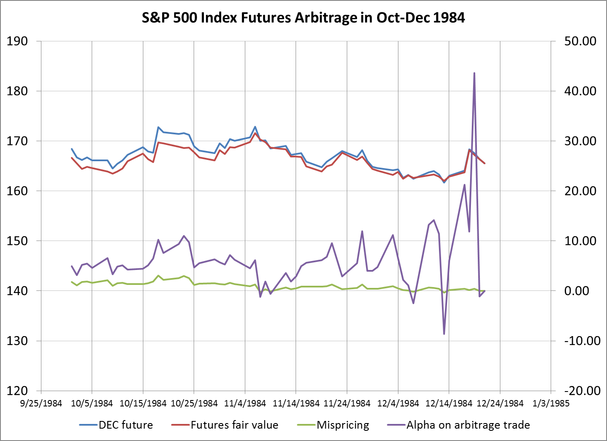
Cash and Carry Arbitrage in Index Futures, Fall 1984

Slide 84
Coming of Age for Index Futures Arbitrage
By 1987, index futures arbitrage had already become a "commodity business"
low profit because all the big firms were doing it
October 19, 1987: The stock market had its biggest loss in history.
Futures ran way ahead of the cash market on the way down
We learned that replicating a put option by dynamic trading of index futures is a lot less protection than owning an actual put. ("Portfolio Insurance" crashed and burned.)
Index arbitrage was widely blamed for the crash. Program trading for index arbitrage was banned for over a month.
Over the next few years, a variety of "circuit breakers" designed to disconnect the stock market from the futures market in times of stress were tried.
FINC-GB.2349 Spring 2017
Trading Cash and Derivative Securities ©2017 Figlewski

Slide 85
Index Arbitrage in a Mature Market
By 1990, index arbitrage was fully mature
George Sofianos, in the lead article of the first issue of the Journal of Derivatives, Fall 1993, documented how index arbitrage was being done in practice.
Sofianos examines 2659 index arbitrage trades from Jan. 15 – July 13, 1990
He reports:
arbitrage opportunities were small and disappeared within 3 minutes, on average
average arbitrage profit on trades was -0.4% if carried to expiration
70% of positions were closed out early when mispricing reversed
the average time between profitable reversals was 24 hours; trades closed this way earned excess returns of about 5%
37% of trades involved legging into the position: risky, but did not seem to affect average returns
the average number of stocks used was 280, with 8% of trades using 70 or fewer
FINC-GB.2349 Spring 2017
Trading Cash and Derivative Securities ©2017 Figlewski

Slide 86
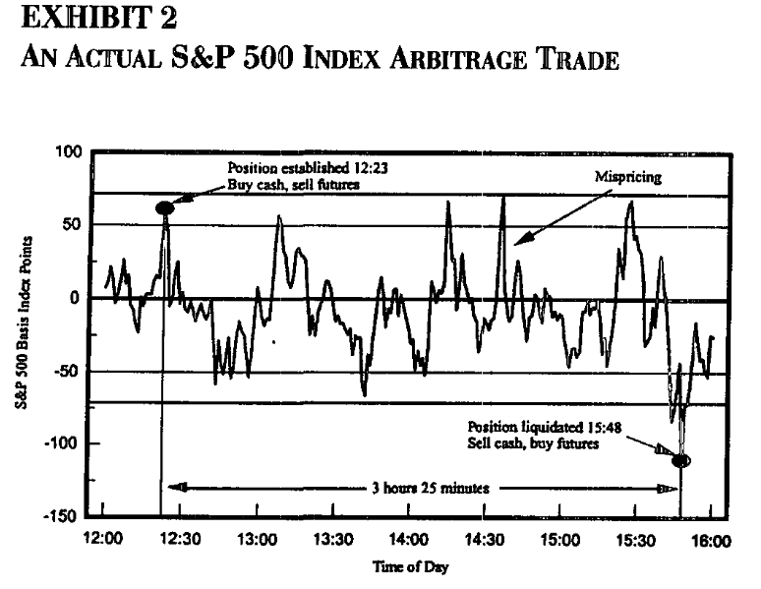
Index Arbitrage in a Mature Market
from Sofianos, JOD Fall 1993

Slide 87
Index Arbitrage in a Mature Market
Stock index arbitrage is sometimes described as "picking up nickels in front of a steam roller." Profits are modest and entail many risks that might crush you.
Stock portfolios are traded as units, using "program trades"
Market impact ("bid-ask bounce")
Execution risk
Sometimes "Circuit breaker" restrictions on program trading
Short sales
need to find shares to short and to pay the lender a fee to borrow the stock
short sales are allowed only on an uptick or constrained in other ways
a natural advantage for an institutional investor that already owns all the stocks
Unwinding
at expiration, using "market on close" orders ("market on open" these days) can save one market impact; leads to the "Triple Witching Hour"
early unwinding increases transactions costs and execution risk
Rogue traders
Nick Leeson (Barings, $1.4B); Jérôme Kerviel (Soc. Gen., $6.7B); Kweku Adoboli (UBS, 2.3B)
FINC-GB.2349 Spring 2017
Trading Cash and Derivative Securities ©2017 Figlewski

Slide 88
Arbitrage in a Mature Market
Lessons to take away from the evolution of the stock index futures market
The futures market (more generally, a market for some derivative contract) is connected to the underlying cash market by arbitrage.
Models for valuation and for hedging come from arbitrage (or the more general "Law of One Price").
How closely connected the markets are depends on how easy or hard it is to do the arbitrage trade
  transactions costs
  risks
  theoretical price relationships among derivatives are typically stronger than between the derivative and the underlying cash market
In a market where the arbitrage trade is cheap and easy, arbitrage opportunities still arise, but are small, short-lived, and typically risky
Often there is asymmetrical behavior between the long side and the short side. Arbitrage to correct underpricing of futures tends to be weaker because you have to short the cash market security.
Not everyone can do the trade profitably. Arbitrage will be dominated by the lowest cost and most agile arbitrageurs.
Trading in a derivative can have strong effects on the underlying.
FINC-GB.2349 Spring 2017
Trading Cash and Derivative Securities ©2017 Figlewski

Slide 89
GB.2349: Trading in Cash and Derivatives Securities – Spring 2016
Session 3:
Technical Trading
Trading on Public Information
      Fundamental Analysis
      "Value and Momentum Everywhere"
      Carry
      ...and more
FINC-GB.2349 Spring 2017
Trading Cash and Derivative Securities ©2017 Figlewski

Slide 90
Trade like a Turtle?
The Ugly Truth about System Sellers
"One of the sad realities of the trading industry...is that there are far more people making money selling others systems and 'ways to make money trading' than there are people actually making money trading."
The Original Turtle Trading Rules, p.2
FINC-GB.2349 Spring 2017
Trading Cash and Derivative Securities ©2017 Figlewski

Slide 91
Technical Analysis
Technical Analysis encompasses a wide variety of trading strategies that are based only on the behavior of the price series, not underlying "fundamentals."
Technical analysis tries to uncover trends or more complicated patterns that better-than-random predictions of how the price will behave in the future.
  One might expect serial correlation to be positive in a market that exhibits longer and stronger trends than a random walk.
  Traders say "The Trend is Your Friend," but it is hard to prove that prices for stocks or other financial variables do in fact move in trends more often than random series.
  A profitable trading rule must signal a trend has begun early enough for the trader to get in. The trend must be long. And the rule must signal when the trend is over early enough that the trader exits before the profit has all been given back.
FINC-GB.2349 Spring 2017
Trading Cash and Derivative Securities ©2017 Figlewski

Slide 92
Trade like a Turtle?
The Turtle System is a complete set of rules for what and how to trade.
"Using a mechanical system is the best was to consistently make money trading." (p.9)
"The most important aspects of successful trading are confidence, consistency, and discipline." (p.3)
The Original Turtle Trading Rules
FINC-GB.2349 Spring 2017
Trading Cash and Derivative Securities ©2017 Figlewski

Slide 93
Trade like a Turtle?
Most of the Turtle rules deal with risk management (position size, placing stops).
Prices to enter or exit a trade are based on a "breakout"
20-day breakout: price is above highest price in last 20 days.
Entry/Exit points: Put a trade on when there is a breakout, take it off when there is a 10-day breakout against the position.
FINC-GB.2349 Spring 2017
Trading Cash and Derivative Securities ©2017 Figlewski

Slide 94
Trade like a Turtle?
Turtle Questions
What kind of price moves does this strategy require to be profitable?
Why use stops? Why not use stops? (How about a "stop-limit" order?)
Where do 20 and 55 days come from? Do they never change?
Would an emotionless robot be a better trader than a human using a mechanical system like this?
(What about computer-driven high frequency trading? Is it more profitable with or without humans?)
How mechanical was the Turtle System really? (e.g., use of limit orders vs. "always trade immediately at the breakout")
FINC-GB.2349 Spring 2017
Trading Cash and Derivative Securities ©2017 Figlewski

Slide 95
Technical Analysis
  Filter Rules
  One common and simple technical strategy is a filter rule. An x% filter rule says buy when the price closes x% above its most recent low and sell after it has reached a peak and then declined x% below it.
  Alexander (1961, 1964) tested the strategy on stocks. He first mistakenly considered a filter rule that was non-operational in practice. When he corrected the mistake, he found no significant excess return to filter rules except over the very shortest time intervals.
  Returns to tiny filters should more appropriately be considered returns to market makers who profit from the "bid-ask bounce" as compensation for providing liquidity.
  transactions costs for non-market makers are too high to profit from such small price changes.
FINC-GB.2349 Spring 2017
Trading Cash and Derivative Securities ©2017 Figlewski

Slide 96
Technical Analysis
  Rules based on Moving Averages
Another common technical trading strategy is based on moving averages. A k-day moving average is the average of prices over the previous k days.
One typical form of the trading rule computes two moving averages, over k and m days, with k < m. For example, k = 100, m = 200.
If the k-day moving average is above the m-day moving average, it is interpreted as a sign of strength: a buy signal.
If the k-day moving average is below the m-day moving average, the market is showing weakness: a sell signal
Such trading rules should not work in a market that is weak-form efficient.
But some markets have active, or occasional, trading by central banks to smooth price movements (exchange rates, short term interest rates). This may produce nonrandom patterns to be exploited.
FINC-GB.2349 Spring 2017
Trading Cash and Derivative Securities ©2017 Figlewski

Slide 97
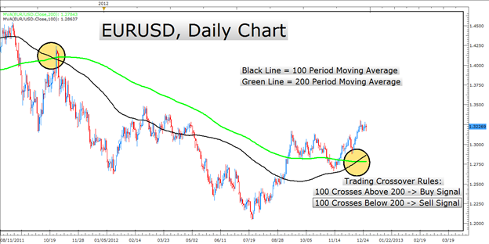
Technical Analysis: Moving Average Rule
FINC-GB.2349 Spring 2017
Trading Cash and Derivative Securities ©2017 Figlewski

Slide 98
Technical Analysis
  Rules based on Moving Averages
Silber, in "Technical Trading: When it Works and When it Doesn't" (Journal of Derivatives, 1994) studied moving average rules on 12 futures contracts, properly testing the strategies out of sample
uses nearby maturity contract, with suitable rules for rolling over to the next maturity when expiration gets close
chooses most profitable combination of k- and m-day moving averages on all past data, then computes profitability over the next year.
after each year's out of sample results are tabulated, that year is added to the price history and new values of k and m are computed from the extended sample.
the out of sample mean returns are ranked by their Sharpe ratios
all of the FX futures have positive t-statistics and 4 of 6 are significant at better than 5% after transactions costs.
rules for crude oil, British 3-month interest rates and US Treasury bonds were also profitable but not significant
silver, gold and the S&P500 were unprofitable
FINC-GB.2349 Spring 2017
Trading Cash and Derivative Securities ©2017 Figlewski

Slide 99
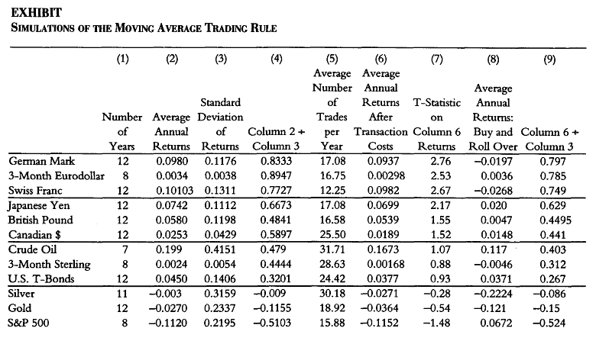
Technical Analysis: Results from Silber, JoD 1994
Alternative
"Buy and Hold"
strategy
Gross
Sharpe
ratio
Net
Sharpe
ratio
t-stats on
net return
FINC-GB.2349 Spring 2017
Trading Cash and Derivative Securities ©2017 Figlewski

Slide 100
Technical Analysis
Chart Patterns
Technical analysts put great store in chart patterns that are believed to reveal "support" and "resistance" in the market.
support is a price level where investors are expected to buy aggressively, which tends to keep the market price above the support
support at a given price develops, and is revealed, when the market drops to that price but bounces off, and goes back up; the more often this happens, the stronger the support
if the price breaks through the support, a downward trend will follow
resistance occurs at a price level where a market advance has been stopped
repeated failure to penetrate that price increases the resistance, and a breakout is a strong bullish signal
once a support level is penetrated, it may become a resistance level for the next price advance; similarly, a resistance level can become support once the market breaks through it
FINC-GB.2349 Spring 2017
Trading Cash and Derivative Securities ©2017 Figlewski

Slide 101
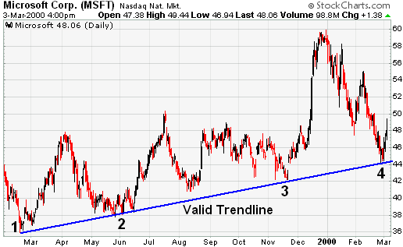
Common Chart Patterns—Trendlines
Buy when the price descends to the trendline, because that is where there is support. A breakout on the downside signals the trend is over.
FINC-GB.2349 Spring 2017
Trading Cash and Derivative Securities ©2017 Figlewski

Slide 102
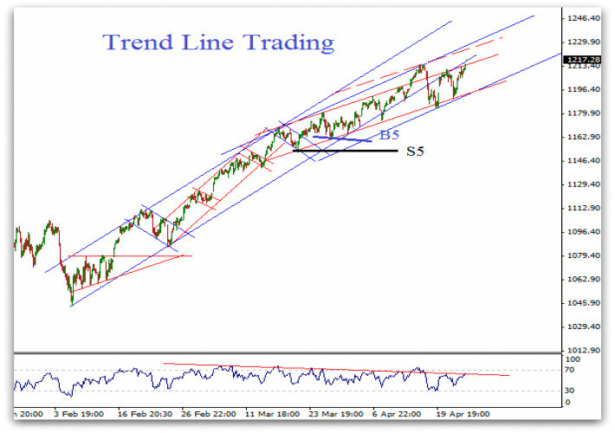
The Problem with Trendlines
Which ones are meaningful?
Note that a "trendline" is not the same thing as a trend.
FINC-GB.2349 Spring 2017
Trading Cash and Derivative Securities ©2017 Figlewski

Slide 103
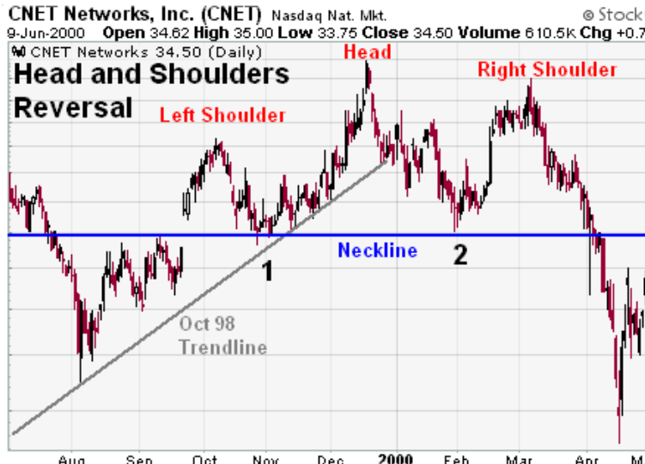
Common Chart Patterns—Head and Shoulders
Is this pattern valid?
Could you trade on the breakout?
Self-fulfilling prophecy?
FINC-GB.2349 Spring 2017
Trading Cash and Derivative Securities ©2017 Figlewski

Slide 104
Technical Analysis
Bottom Line Question for Any Technical Trading System
Does it make sense that this system based only on price data everyone in the market is thoroughly familiar with should produce excess returns in many (most?) financial markets over a long period of time?
If so, why?
FINC-GB.2349 Spring 2017
Trading Cash and Derivative Securities ©2017 Figlewski

Slide 105
News Events and Market Prices
A weak-form efficient market does not allow excess returns to any kind of trading strategy based only on patterns in past prices. Technical analysis should not work.
A semi-strong form efficient market does not allow excess returns to be made based on any information that is already known to the market.
Release of an unanticipated major piece of information is expected to have a large and immediate price impact. Similarly, one expects that a big price move should only be caused by major news.
Cornell, in "What moves stock prices: Another look. " (Journal of Portfolio Management, 2013) reports on an earlier study from 1989 that explored what news events triggered big price changes in the stock market. He then updated the study to cover the 50 largest price changes from 1988-2012.
Neither study could find anything particular in the news that distinguished a really big up or down day in the stock market from any other day. What specific things actually trigger a big rally or a crash remain a mystery. What distinguishes "the straw that broke the camel's back" from all of the previous straws that didn't?
If we can't figure out what moved the market even after the fact, what hope is there of predicting major market moves in advance?
FINC-GB.2349 Spring 2017
Trading Cash and Derivative Securities ©2017 Figlewski

Slide 106
Inherent Problems in Performance Measurement
Common Problems to Watch Out for in Statistical Market Research
Out of sample testing is crucial: no peeking into the future
Survivorship bias: big losers are dropped from historical databases
Data snooping: models are not developed independently from knowledge of past data
Choice of benchmark:
  alpha? Sharpe ratio?
  S&P500?, broader stock index?, index including bonds and other assets?, how about real estate?, foreign stocks?, human capital?...????
Peso problems: market prices can (and should) reflect possible rare disasters that haven't occurred before in the historical sample
Time-variation in underlying system: nothing stands still—the system can evolve faster than it generates the data needed to measure and model its current state accurately
Unknown and non-normal distributions: locations of the 5%, or 1% or any% tails are not known and there are few occurrences in the recent past to judge those probabilities
FINC-GB.2349 Spring 2017
Trading Cash and Derivative Securities ©2017 Figlewski

Slide 107
Measuring Performance: Beyond the CAPM
Original CAPM:
Fama and French ("Common risk factors in the returns on bonds and stocks." JFE, 1993) developed an extended Capital Asset Pricing Model, with two extra factors:
  SMB: "small minus big" – the difference between the returns on small cap stocks and large cap stocks
  HML: "high minus low" ratio of book to market value of equity
Fama-French 3-factor model:
Carhart ("On persistence in mutual fund performance." JFin, 1997) added another factor to capture the effect of year-to-year momentum in returns (average of highest 30% last year returns minus average of lowest 30% )
Carhart 4-factor model:
FINC-GB.2349 Spring 2017
Trading Cash and Derivative Securities ©2017 Figlewski

Slide 108
Measuring Performance: Testing a Hypothesis
Some firms are in industries that a significant fraction of the investor population disapproves of, such as tobacco companies and casinos, while other firms are virtuous and promote themselves as "socially responsible," like wind farms and "green" manufacturers.
Hypothesis: Firms in "sin" industries underperform stocks in other industries.
Is this likely to be true? Why or why not?
How should one go about testing this hypothesis?
FINC-GB.2349 Spring 2017
Trading Cash and Derivative Securities ©2017 Figlewski

Slide 109
Measuring Performance: Testing a Hypothesis
Fabozzi, Ma, and Oliphant (JPM Fall 2008). "Sin Stock Returns" tested this hypothesis.
Combined data for
21 countries, 267 stocks
6 industries [Adult Services, Alcohol, Weapons, Gambling, Biotech, Tobacco]
30 years [1970 – 2007]
Compared returns against the national stock market indexes, with and without adjustment for beta.
FINC-GB.2349 Spring 2017
Trading Cash and Derivative Securities ©2017 Figlewski

Slide 110
Measuring Performance: Testing a Hypothesis
Caption to Table 4: Sin Industry Stock Returns, 1970-2007
FINC-GB.2349 Spring 2017
Trading Cash and Derivative Securities ©2017 Figlewski

Slide 111
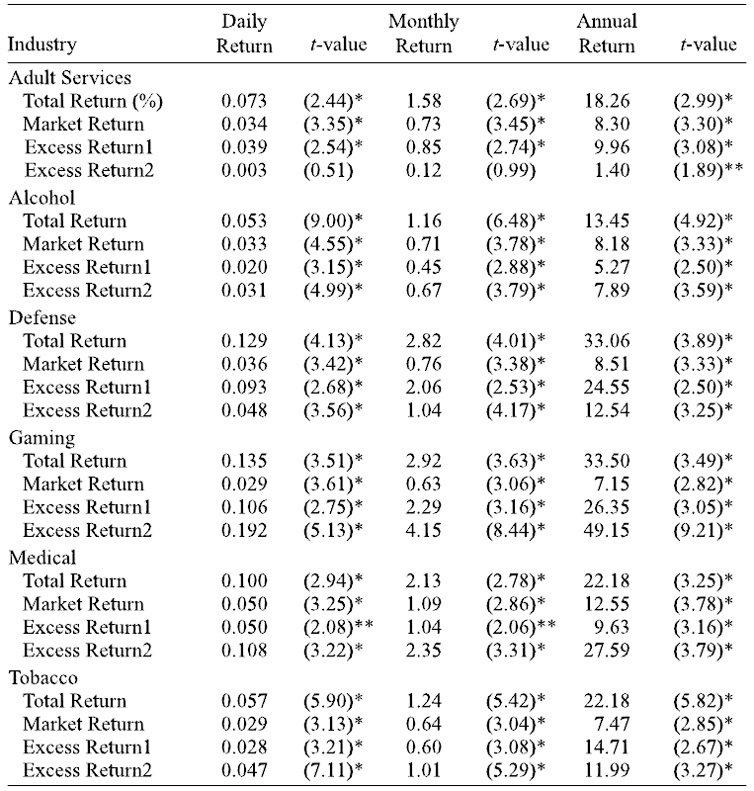

Slide 112
Measuring Performance: Beyond the CAPM
Despite its intellectual appeal to theorists, and the strong empirical evidence of a common "market" factor shared by all stocks, the CAPM has been singularly unsuccessful as a model of returns.
During the 1980s and early 1990s, a variety of "anomalies" (apparent systematic violations of efficient markets) were uncovered:
Calendar effects: the "January Effect" was the best known, but there are day-of-the-week effects (Mondays are not good days), time-of-day effects, and other seasonal patterns like "Sell in May and go away."
Small firm effect: small capitalization firms outperform large cap firms (especially in January)
Book-to-market effect: stocks whose market prices exceed book values by the largest amount perform the worst
Momentum effects: stocks that outperformed the market last year continue outperforming this year, but not over the longer run; negative momentum holds for underperformance
...and many others! (But Malkiel tries to debunk them all.)
FINC-GB.2349 Spring 2017
Trading Cash and Derivative Securities ©2017 Figlewski

Slide 113
The Current State of Academic Research
Recent research by Lasse Pedersen and a collection of coauthors (Asness, Frazzini, Koijen, Moskowitz, Vrugt) has dug a lot deeper into what factors produce profitable investment strategies.
  very broad data samples with multiple asset classes, many countries, long time periods, and MANY variations to demonstrate robustness
  trading strategies to exploit their results are implementable
They reexamine returns to factors that academics like Fama and French, as well as non-academics have focused on:
  "value" vs. "growth" stocks (measured by book-to-market)
  momentum (Carhart's factor)
  carry (cash payout minus financing costs),
  "quality" (low risk, high return, growing, well-managed firms)
They produce strong evidence of excess returns and
  high returns to value and momentum are pervasive, but seem really to be at least partly due to liquidity
  both carry and "quality minus junk" earn excess returns
    (1) Why?
    (2) How long will it last after the research results have been published?
FINC-GB.2349 Spring 2017
Trading Cash and Derivative Securities ©2017 Figlewski

Slide 114
"Value and Momentum Everywhere"
Asness, Moskowitz, and Pedersen. Journal of Finance, June 2013.
The breadth of the sample, and the fact that the same results are obtained for all markets and asset classes, is extraordinary
Geographical regions: Major markets in US, UK, Continental Europe, Japan
Time period: monthly, mostly 1974 – 2011.
Asset classes:
Individual stocks: All large liquid stocks; firms cover top 90% of total capitalization in each market (roughly the largest 20% of firms); 4 regions examined separately
Equity Indexes: From 18 countries
Currencies: 10 countries
Government bonds: short term and 10 year, 10 countries
Commodity futures: 27 commodities
FINC-GB.2349 Spring 2017
Trading Cash and Derivative Securities ©2017 Figlewski

Slide 115
"Value and Momentum Everywhere"
Statistical measures:
  Use simplest and most standard measures, checking many alternatives to be sure results are robust
"Value" =
  stocks: Book to Market (What about Berkshire Hatheway?)
  stock indexes: Book to Market for MSCI country index
  commodities: log( price 5 years ago / today's price )
  currencies: log( exchange rate 5 years ago / today's rate ) - log( local inflation / US inflation )
  bonds: change in yield over last 5 years
"Momentum" = (for all asset classes)
  Past 12-month return, not including last month (to avoid possible short term reversal effect)
Form 48 portfolios
  High / Middle / Low exposure to each factor
  Two factors (value / momentum)
  Eight asset classes
  also a 50/50 portfolio and 2 pure play factor portfolios
FINC-GB.2349 Spring 2017
Trading Cash and Derivative Securities ©2017 Figlewski

Slide 116
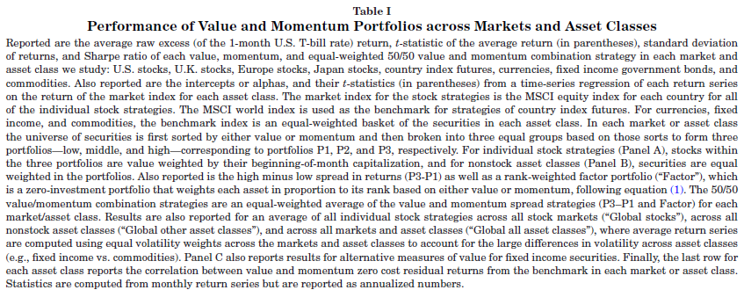
"Value and Momentum Everywhere"
FINC-GB.2349 Spring 2017
Trading Cash and Derivative Securities ©2017 Figlewski

Slide 117
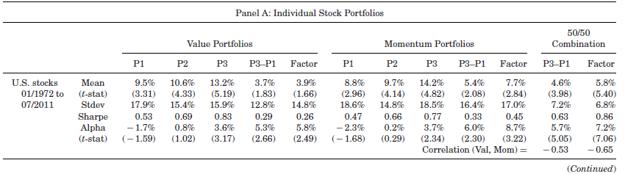
"Value and Momentum Everywhere"
5 Portfolios for each strategy:
P1 (lowest Value or Momentum), P2 (medium), P3 (highest)
P3-P1 (long highest and short the lowest)
Factor (all stocks, with weights proportional to how far above (+) or below (-) the
population average it is)
plus a 50/50 combo of both strategy P3-P1 and Factor portfolios
Performance Statistics:
mean return; standard deviation; Sharpe ratio; and alpha relative to national index
t-statistics above about 1.7 (2.4) indicate statistical significance at the 5% (1%) level
also note the strong negative correlation between strategies

Slide 118
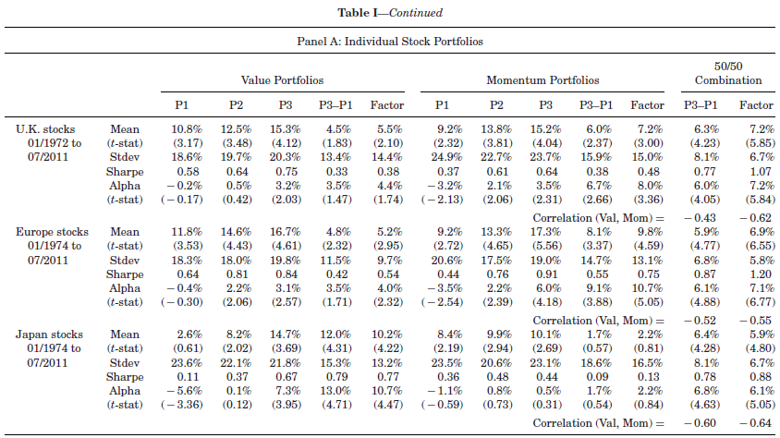
"Value and Momentum Everywhere"
FINC-GB.2349 Spring 2017
Trading Cash and Derivative Securities ©2017 Figlewski

Slide 119
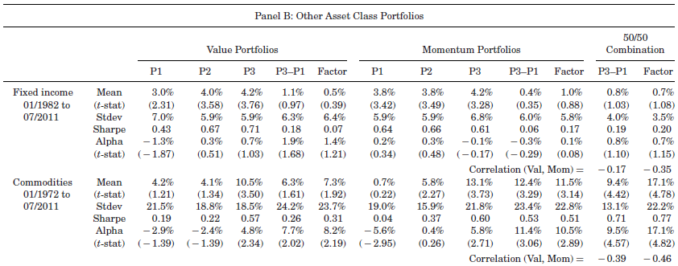
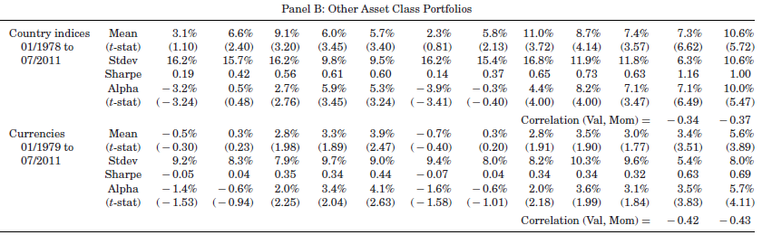
"Value and Momentum Everywhere"

Slide 120
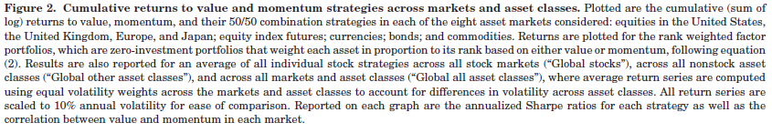
"Value and Momentum Everywhere"
FINC-GB.2349 Spring 2017
Trading Cash and Derivative Securities ©2017 Figlewski

Slide 121
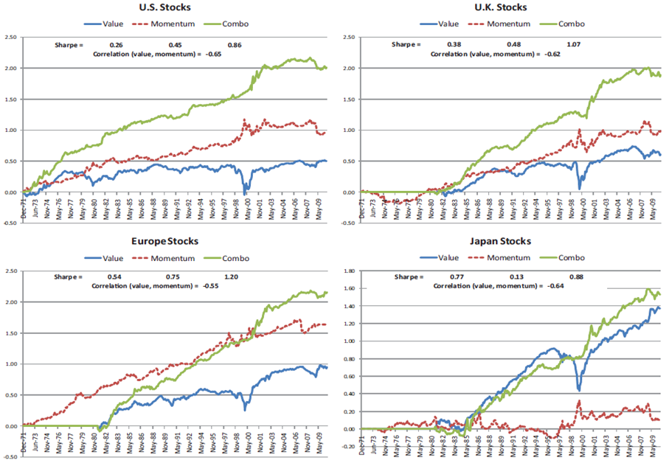
#################################################
#################################################
#################################################
#################################################
#################################################
#################################################
#################################################
#################################################
#################################################

Slide 122
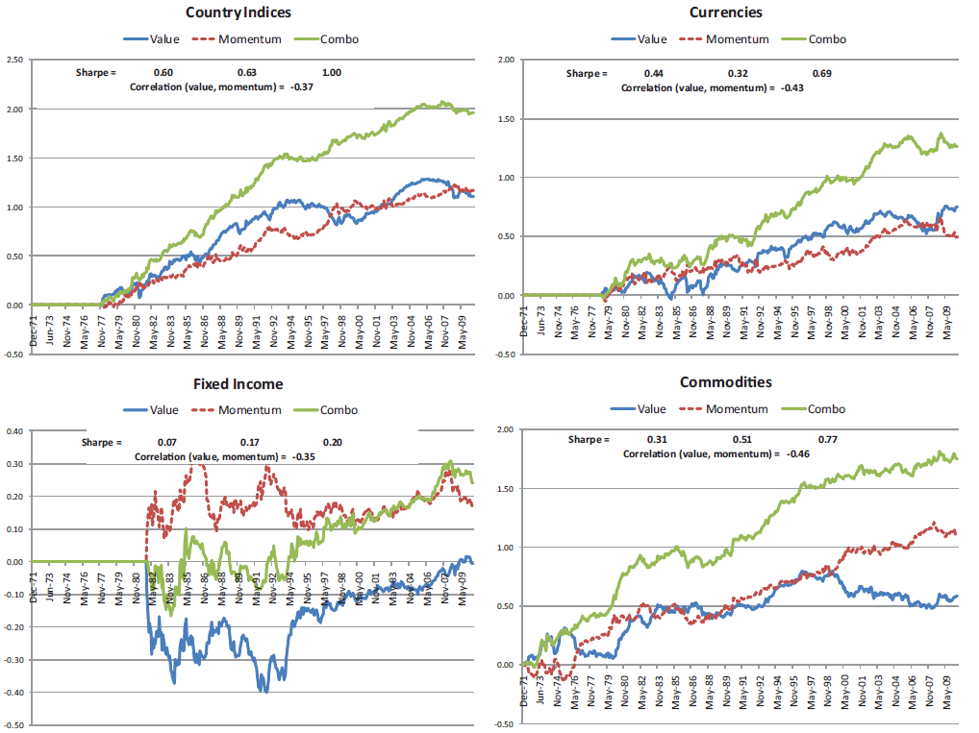

Slide 123
"Value and Momentum Everywhere"
Notable points:
The value and momentum returns phenomena are consistent and obvious across a large fraction of all traded assets worldwide.
The two factors are strongly negatively correlated:
A high book to market stock also tends to be one with low momentum.
Looking at these factors one at a time hides their strong and different impacts
"Factor" portfolios are formed as zero cost (i.e., half long and half short), with weighting related to the rank of the individual stock exposures to the factor, e.g., the stock with the highest (lowest) momentum gets the largest (most negative) weight.
Combining different asset classes, different countries, and the two exposures produces very low risk-high return investments.
FINC-GB.2349 Spring 2017
Trading Cash and Derivative Securities ©2017 Figlewski

Slide 124
"Value and Momentum Everywhere"
Bottom line: What's going on?
Asness, Moskowitz, and Pedersen believe that liquidity is the driving force here.
Liquidity can mean:
(a) The market's bid-ask spread is relatively narrow, and you can buy or sell a large quantity without moving the price very much. (market liquidity)
(b) You can easily borrow against the security to carry it. (funding liquidity)
They produce strong statistical evidence in favor of their idea.
Question for discussion: How long should we expect trading strategies based on these results to remain profitable?
FINC-GB.2349 Spring 2017
Trading Cash and Derivative Securities ©2017 Figlewski

Slide 125
Tricks to increase statistical power
Some of the major methodological innovations that modern-era finance research introduced include
incorporating risk exposure along with returns in measuring performance
measuring performance relative to an alternative "passive" strategy
testing ideas by combining individual securities into portfolios (to reduce "noise" by diversification, and focus on a single attribute)
concern about whether and how a strategy could be implemented in the real world (out of sample testing; transactions costs; data availability (can you get the info in time?); execution (can you get the trades done?—IMPORTANT, but hard to test! )
Current academic-style empirical work in finance employs several techniques to enhance statistical power, including
principal components (to reduce a large number of related explanatory variables into one or a small number of the most important factors)
time and asset class fixed effects (to reduce spurious results due to things that affected all assets during specific time periods, or that cause one specific asset to be systematically different from others in a particular way)
extensive "robustness" testing
FINC-GB.2349 Spring 2017
Trading Cash and Derivative Securities ©2017 Figlewski

Slide 126
Carry
Stocks pay dividends. Bonds pay coupon interest. Foreign currency trades allow you to capture the interest rate differential between two countries.
The rate of cash payout is the "carry." Carry is known at the beginning of a trade, so it is treated as risk free.
The total return on an investment is equal to the cash payout plus the price change, e.g., dividends plus capital gains for a stock.
The expected return = carry + expected capital gain/loss.
Risk is in the unexpected price change.
FINC-GB.2349 Spring 2017
Trading Cash and Derivative Securities ©2017 Figlewski

Slide 127
Carry
Carry, as a percent of asset value, changes as the cash payouts go up and down, and as the asset price goes up and down.
What happens to total return when carry goes up?
Maybe,
the expected return (i.e., risk premium) stays the same; expected capital gain goes down (the market adjusts to keep total expected return the same)
or, expected capital gain stays the same; expected total return goes up by the amount of the increase in carry
or, expected capital gain goes down a little; total expected return is higher, but by less than the increase in carry;
or, expected capital gain increases also; expected total return goes up by more than the amount of the increase in carry;
or, expected capital gain goes down a lot; total expected return is lower.
Outcomes 2,3, or 4 imply that carry (known at the beginning) predicts total returns (known only at the end).
FINC-GB.2349 Spring 2017
Trading Cash and Derivative Securities ©2017 Figlewski

Slide 128
Carry
In "Carry", Koijen, Moskowitz, Pedersen, and Vrugt (KMPV) look at this question for a huge number of assets and markets around the world. Their results show strongly that carry is an important and pervasive factor that produces excess returns in all of the markets they consider.
FINC-GB.2349 Spring 2017
Trading Cash and Derivative Securities ©2017 Figlewski

Slide 129

"Carry" by Koijen, Moskowitz, Pedersen, and Vrugt
The arbitrage-based model for the fair value of the forward exchange rate, that we looked at earlier, sets the forward rate so that the arbitrage trade of
borrowing in one country,
converting to a foreign currency,
investing in that country's interest rate,
and locking in the future exchange rate to bring back the proceeds at maturity
yields exactly zero excess return.
"The Carry Trade" that has attracted a lot of trading interest is based on not hedging the forward exchange rate, but assuming (hoping!) it will not move against you (i.e., the exchange rate on the foreign currency depreciates, leaving you with a loss in terms of your home currency).
To allow consistency in definitions across widely different asset classes, KMPV define commodity carry as
For FX, (Note the period is 1 year)
For stocks,
FINC-GB.2349 Spring 2017
Trading Cash and Derivative Securities ©2017 Figlewski

Slide 130
"Carry" by Koijen, Moskowitz, Pedersen, and Vrugt
Markets:
  13 country stock index futures
  20 exchange rates
  24 commodities
  10 countries' government bond yield curves (with 3 different carry measures)
  US Treasury bonds, 6 maturity buckets
  US Credit markets for intermediate and long maturity AAA, AA, A, and BAA corporates
  Stock index options on 10 different US stock indexes
  portfolios combining these
FINC-GB.2349 Spring 2017
Trading Cash and Derivative Securities ©2017 Figlewski

Slide 131

"Carry" by Koijen, Moskowitz, Pedersen, and Vrugt
FINC-GB.2349 Spring 2017
Trading Cash and Derivative Securities ©2017 Figlewski

Slide 132

##########################################################
##########################################################
##########################################################
##########################################################
##########################################################
##########################################################
##########################################################
##########################################################
##########################################################

Slide 133

stuff
##########################################################
##########################################################
##########################################################
##########################################################
##########################################################
##########################################################
##########################################################
##########################################################
##########################################################

Slide 134
Carry
Additional results, and extensive robustness checks, provide persuasive evidence that
Carry is an important component of returns across a broad range of asset classes
Carry is (was!) apparently underappreciated in the market, so trades with great Sharpe ratios are (were!) possible (Why? How can this be? What will happen going forward?).
Carry does not appear to be related to other known risk factors, so it is not proxying for something else, and its risk is diversifiable.
FINC-GB.2349 Spring 2017
Trading Cash and Derivative Securities ©2017 Figlewski

Slide 135
Quality Minus Junk
The characteristics that make a stock an obviously desirable one can be summed up, logically, into a single one: "Quality". In "Quality Minus Junk," Asness, Frazzini and Pedersen check to see if visibly high quality stocks sell for higher prices than otherwise identical low quality "junk" stocks.
If the market doesn't put a high enough price on quality, then a "Quality-minus-Junk" QMJ factor should earn excess returns. This is what they find.
As usual, they examine an overwhelming number of stocks:
over 39,000 stocks
24 countries
"long" data sample for US: 1951-2012
"broad" data sample for 24 countries: about 1986-2012
FINC-GB.2349 Spring 2017
Trading Cash and Derivative Securities ©2017 Figlewski

Slide 136

Quality Minus Junk
The basic idea is to measure the appropriate market to book ratio given the quality characteristics of the stock that should determine the market price.
Gordon Growth Model: A stock should be worth the present value of its expected dividend flow over the infinite future.
If D = next period dividend;
r = riskless rate
π = appropriate risk premium for the stock
g = growth rate of earnings/dividends over the long run
Then $Fair stock price= \frac{D}{\left(r+π\right)−g}$
The proxies for "quality" relate to the various factors in this expression.
FINC-GB.2349 Spring 2017
Trading Cash and Derivative Securities ©2017 Figlewski

Slide 137
Quality Minus Junk
"Quality" = profitability, growth, safety, and dividend payout
Profitability: {gross profit/assets; return on equity; cash flow; etc.}
Growth: { 5 year growth in the profitability variables}
Safety: { beta; idiosyncratic volatility; low leverage; etc.}
Payout: { fraction of earnings paid out}
Proxies in each of these categories are averaged, then the categories are averaged to get the overall quality measure.
FINC-GB.2349 Spring 2017
Trading Cash and Derivative Securities ©2017 Figlewski

Slide 138

Quality Minus Junk
FINC-GB.2349 Spring 2017
Trading Cash and Derivative Securities ©2017 Figlewski

Slide 139

Quality Minus Junk

Slide 140

Quality Minus Junk
FINC-GB.2349 Spring 2017
Trading Cash and Derivative Securities ©2017 Figlewski

Slide 141

Quality Minus Junk
FINC-GB.2349 Spring 2017
Trading Cash and Derivative Securities ©2017 Figlewski

Slide 142
More Results from Pedersen et al
In "Betting Against Beta" Frazzini and Pedersen build a model with financing constraints such as margin requirements. Investors will pay extra to acquire leverage with high beta stocks. This drives their prices up and mean returns down. As usual, the authors examine tons of data.
high beta means low alpha
a "bet against beta" factor (short high beta stocks and long low beta stocks with leverage) earns significant excess returns
tighter constraints hurts the BaB factor because constrained traders pay up even more for higher betas
more constrained investors hold riskier assets
In "Buffett's Alpha" Frazzini, Kabiller, and Pedersen look at Warren Buffett's performance over more than 30 years. It is extraordinary, but due to several unexceptional factors.
alpha vs Fama-French 3-factors plus momentum is exceptional
adding a "Quality minus Junk" factor and a "Betting against Beta" factor makes the alpha statistically insignificant
Buffett's leverage has averaged about 1.6 to 1
funding risk is reduced by the ability to use reserves from in-house insurance companies
Conclusion: Buffett has won big by following a conservative low-beta-high-quality portfolio strategy leveraged up by 60%. This is very smart, but anyone could have done it.
FINC-GB.2349 Spring 2017
Trading Cash and Derivative Securities ©2017 Figlewski

Slide 143
Appendix to Sessions 3-4
More on Technical Stuff
FINC-GB.2349 Spring 2017
Trading Cash and Derivative Securities ©2017 Figlewski

Slide 144
Principal Components
Consider a collection of related assets, like the top 20% of stocks in the US, the UK, the rest of Europe, and Japan (this is approximately the "Global Stocks" portfolio in Asness, Moskowitz, and Pedersen's "Value and Momentum Everywhere" paper).
Each stock i's return is exposed to a variety of risk factors, different for different markets and with different degrees of exposure to each one.
We might try to figure out exactly what each of the factors is for each country (a broad stock market index, inflation, interest rates, credit conditions, GDP growth, business confidence, etc., etc.)
The CAPM does this with a single market factor plus a separate idiosyncratic factor for each stock.
The Fama-French 3 factor model has 3 common factors plus idiosyncratic terms
FINC-GB.2349 Spring 2017
Trading Cash and Derivative Securities ©2017 Figlewski

Slide 145
Principal Components
This is good but
  you often end up with a whole lot of factors (e.g., one for each industry)
  you have to be able to identify and measure each one.
A related problem occurs when you have a particular factor you think is important, for example, "investor confidence," and you have a number of variables that are all related to that factor, but there is no uniquely best one.
  Michigan Survey of Consumer Confidence
  recent returns in the market
  VIX index
  credit spreads in the bond market
  CDS spreads
  etc.
You don't want to put all of these into a regression model, only a summary measure of the current level of confidence that all of these have in common.
Principal Components is a way to do this statistically, without having to specify exactly how each of the observable variables is connected to the factor you are interested in.
FINC-GB.2349 Spring 2017
Trading Cash and Derivative Securities ©2017 Figlewski

Slide 146
Principal Components
Example: Suppose three stocks are correlated with each other because they are exposed to the same risk factors. The statistical procedure constructs artificial factors that are
  independent from each other
  mean 0 and variance 1.0
  ordered so the first factor explains the largest portion of the common correlation; the second factor explains the largest portion of what is left after taking account of the first factor; etc.
  how much a stock is affected by each factor is called its "factor loadings."
FINC-GB.2349 Spring 2017
Trading Cash and Derivative Securities ©2017 Figlewski

Slide 147
Principal Components
Given the factors, we can try to figure out what risk each one is capturing. In many cases, the first few principal components "explain" nearly all of the variability across the set of related assets.
Principal components on US stocks: The first principal component (by far the most important) is sensitivity to a broad market index.
Principal components on US Treasury bonds:
  the 1st principal component is the overall level of interest rates (~80% of variation in yields)
  the 2nd principal component is the slope of the term structure (~10%)
  the 3rd principal component is the curvature (~3-5%)
  These three principal components explain nearly all of the variation in yields of the entire population of T-bonds.
FINC-GB.2349 Spring 2017
Trading Cash and Derivative Securities ©2017 Figlewski

Slide 148

Time and Asset Class Fixed Effects
A major problem in testing a model is the possibility the variable you are interested in just happened to be high for most of your stocks in a year when the market was hit by important but unrelated events (e.g., nearly all firms' leverage went up in 2008 because the market tanked).
Or, some of your stocks may be consistently out of line with the rest, with respect to the variable you are interested in (e.g., banks nearly always have higher leverage than other firms).
If your sample has a number of years and a number of firms each year, you should fit models with year and firm "fixed effects" to adjust for that problem.
This specification says the return on stock i in year t consists of a "time fixed effect" y_{t} that all stocks shared in year t, plus a "firm fixed effect" c_{i} that is the same for stock i in every year but different for each different stock, plus the effect of the specific factor you are interested in a_{i} F_{i,t}, plus a random error.
FINC-GB.2349 Spring 2017
Trading Cash and Derivative Securities ©2017 Figlewski

Slide 149
Robustness Checks
What is the best way to measure momentum? Return over the last year? Over the last 2 years? Relative to the S&P 500? Relative to the Fama-French 3-factor model? Relative to a market portfolio including bonds? Or what?
????
Obviously, no one knows.
But if you try to publish your work in a top journal like the Journal of Finance (or dare to present it in a seminar to the Finance faculty at Stern), every choice will be questioned and multiple alternatives will be suggested as maybe better, or at least things you should have explored.
Virtually all good research papers these days present their story and then conduct numerous "robustness checks" to verify that the story still holds if different plausible choices are made.
This is great science, though it can be mighty boring to read.
FINC-GB.2349 Spring 2017
Trading Cash and Derivative Securities ©2017 Figlewski

Slide 150
GB.2349: Trading in Cash and Derivatives Securities – Spring 2017
Session 4:
Behavioral Investors
FINC-GB.2349 Spring 2017
Trading Cash and Derivative Securities ©2017 Figlewski

Slide 151

Measuring Performance: Beyond the CAPM
The CAPM Underperforms
Baker, Bradley and Wurgler ("Benchmarks as limits to arbitrage: Understanding the low-volatility anomaly." Financial Analysts Journal, 2011) present strong and highly disturbing results on the returns to risk-bearing in stocks.
FINC-GB.2349 Spring 2017
Trading Cash and Derivative Securities ©2017 Figlewski

Slide 152


Measuring Performance: Beyond the CAPM
The CAPM Underperforms
Baker, Bradley and Wurgler ("Benchmarks as limits to arbitrage: Understanding the low-volatility anomaly." Financial Analysts Journal, 2011) present strong and highly disturbing results on the returns to risk-bearing in stocks.
Lowest risk: $1in 1968
→ $59.55 ($10.12 real)
in 2011
Highest risk: $1in 1968
→ $0.58 ($0.10 real)
in 2011
FINC-GB.2349 Spring 2017
Trading Cash and Derivative Securities ©2017 Figlewski

Slide 153

Measuring Performance: Beyond the CAPM
The CAPM Underperforms
FINC-GB.2349 Spring 2017
Trading Cash and Derivative Securities ©2017 Figlewski

Slide 154

Measuring Performance: Beyond the CAPM
The CAPM Underperforms
FINC-GB.2349 Spring 2017
Trading Cash and Derivative Securities ©2017 Figlewski

Slide 155

Baker, Bradley, Wurgler Table 1
FINC-GB.2349 Spring 2017
Trading Cash and Derivative Securities ©2017 Figlewski

Slide 156
Behavioral Finance
We know a lot about how rational expected utility maximizing investors ought to behave in a stylized market environment.
But actual investors often don't behave so "rationally."
A large amount of very interesting and provocative research by Daniel Kahneman and Amos Tversky, and others, has shown that human beings behave in numerous specific ways that systematically violate our "axioms of rational choice." Kahneman won the Nobel Prize in Economics in 2002 for his work.
Terry Odean and coauthors, and many others, have developed applying these ideas to finance into what has now become a major research area known as Behavioral Finance.
FINC-GB.2349 Spring 2017
Trading Cash and Derivative Securities ©2017 Figlewski

Slide 157
Behavioral Finance
There are two basic flavors of behavioral finance.
1. Understanding how features of the real world trading environment that are not captured in the theoretical models affect rational behavior. The key point is that actual investors are behaving rationally given the context
limits to arbitrage
short sale restrictions when investors have heterogeneous expectations
importance of liquidity
predatory trading
2. Exploring trading behavior that is systematic but not rational
overconfidence (leads to overtrading and weak risk management)
loss aversion (reluctance to realize losses)
"disposition effect" (holding losers too long and selling winners too early)
attention (trading "hot" stocks, focusing too much on recent events, "window dressing")
inability to evaluate low probabilities appropriately (either ignoring them or worrying too much)
insufficient attention to transactions costs and fees
FINC-GB.2349 Spring 2017
Trading Cash and Derivative Securities ©2017 Figlewski

Slide 158
Miller's (JFin, 1977) Analysis of Restriction on Short Sales
In the CAPM, if investors have differing expectations about the value of a stock, those who think it is overpriced sell short. Those who think it is underpriced buy the existing shares and also the virtual shares sold by the short sellers.
Every investor takes a position, long or short, in every stock and every investor's opinion is incorporated in the market price.
In the real world, if short sales are not allowed, the optimists buy the outstanding shares, no one sells short, and the beliefs of the pessimists are not incorporated in the market price.
The stock becomes overpriced relative to average market expectations. The buyers will suffer from the "winner's curse."
The effect will be greater for small stocks that can be held by a small number of extreme optimists, for stocks with a wide range of uncertainty about future returns, by stocks that are highly visible, which increases the potential pool of optimists, etc.
Derivatives can make taking short positions easier and improve market efficiency.
FINC-GB.2349 Spring 2017
Trading Cash and Derivative Securities ©2017 Figlewski

Slide 159

Miller's (JFin, 1977) Analysis of Restriction on Short Sales
Investors not in the upper tail of expectations think the stock is overvalued and should theoretically sell it short, but they can't or won't.
Investors with expectations in the upper tail buy the stock
Market clearing price
with all shares owned
by optimists
FINC-GB.2349 Spring 2017
Trading Cash and Derivative Securities ©2017 Figlewski

Slide 160
Behavioral Finance
Overconfidence
Human beings are overconfident.
believe we know more than we actually do
believe we are more skillful than we are: everyone thinks he/she is above average
we attribute good outcomes to skill and bad outcomes to bad luck
women are also overconfident regarding finance but not so much as men
Overconfident investors
trade too frequently
tend to discount the wisdom of others and of the market
seek out and pay more attention to information that tends to confirm their prior beliefs
fail to consider all risks fully
FINC-GB.2349 Spring 2017
Trading Cash and Derivative Securities ©2017 Figlewski

Slide 161
Behavioral Finance: Overconfidence and Overtrading
Some stats from Barber and Odean's data that covers stock accounts at Schwab over 1991-96
the average household has more than 75% turnover annually in its stock portfolio
the most active quintile of traders have monthly turnover of 21.5%
round trip commissions and bid-ask spread average about 4%
households tilt toward small high-beta stocks
the stocks households choose to sell do better after they are sold than the stocks they buy do after they are purchased
women overtrade less than men so they do less badly
FINC-GB.2349 Spring 2017
Trading Cash and Derivative Securities ©2017 Figlewski

Slide 162

Behavioral Finance: Overconfidence and Overtrading
from Barber and Odean. Journal of Finance, 2000.
FINC-GB.2349 Spring 2017
Trading Cash and Derivative Securities ©2017 Figlewski

Slide 163

Vega in the Real World
"Own-benchmark" is the port-
folio they started the year with

Slide 164

Vega in the Real World
from Barber and Odean. Financial Analysts Journal, Nov/Dec 1999.

Slide 165
Behavioral Finance
Loss aversion and the Disposition Effect
People hate taking losses. They take increased risk if it gives a chance to escape from a losing position.
investors holding a portfolio with losses can get stuck, unwilling to trade
institutional investors also hate to realize the paper losses they already have
brokers are advised to avoid phrases like "You need to just take your lumps and get on with things." in favor of more palatable suggestions like "You need to redeploy your assets into more profitable securities."
"Prospect Theory" is a formal alternative to utility theory as a model of risk attitudes. (Investors are risk averse when they are ahead but become risk-tolerant or even risk-seeking when they are losing.) But prospect theory has had little success empirically.
The "disposition effect" is related to loss aversion. Investors hold on to losing positions—they're averse to realizing the loss—and sell winners too early.
"Anchoring" on the initial purchase price may lead to support and resistance levels.
An investor who buys and then sees the price go down right away will hold on, not accepting the loss. But if the price recovers to the original purchase price he may be eager to get out and escape the loss.
FINC-GB.2349 Spring 2017
Trading Cash and Derivative Securities ©2017 Figlewski

Slide 166

Behavioral Finance: The Disposition Effect
Relative likelihood of closing a position is much higher if it is a profit rather than a loss.
FINC-GB.2349 Spring 2017
Trading Cash and Derivative Securities ©2017 Figlewski
from Barber and Odean. "The behavior of individual investors." 2013

Slide 167
GB.2349: Trading in Cash and Derivatives Securities – Spring 2017
Session 5:
Volatility and Options
Recap of Major Themes
FINC-GB.2349 Spring 2017
Trading Cash and Derivative Securities ©2017 Figlewski

Slide 168



Flowchart of How Volatility Gets into Option Prices and How it is Extracted
Historical
price data
Statistical Estimate of
Future Returns
What a financial econometrician calculates
Forecasts and
other information
What the market actually
predicts: the "P" density
also known as "empirical" or "real world" probabilities
Investors'
Estimate of
Future Returns
Hedging
(risk aversion)
What the options market embeds in option prices, including risk premia: the "Q" density,
Demand for Options
Invert the Black-
Scholes Model
Market
Option Prices
Model-free
Volatility
calculation
Implied BS Volatilities
"Risk-neutral" Probabilities
Volatility smile
Volatility surface
Risk Neutral Density
The original
VIX Index
VXO
Model-free
Implied Volatility;
the VIX Index

Slide 169
Forecasting volatility
Here are some common "stylized facts" from research on the behavior of asset volatility
  volatility is not constant; it changes substantially over time
  periods of high volatility and periods of low volatility cluster together
  there appears to be "mean reversion" in volatility; periods of unusually high or low volatility tend to be followed by a reversion to more normal behavior
  in equity markets, volatility increases when stock prices fall, and (may) decrease when prices rise (this is often called the "leverage effect")
  implied volatility has a regular structure across options with different strike prices, known as the "smile" or the "skew"
  implied volatility also shows systematic "term structure" effects for options with different maturities
FINC-GB.2349 Spring 2017
Trading Cash and Derivative Securities ©2017 Figlewski

Slide 170
What "volatility" do you really want to know?
In the classical Black-Scholes lognormal diffusion model, all aspects of risk are captured by the single volatility parameter σ. But once one departs from this assumption, different volatility-related aspects of the returns process may be relatively more important to some investors than others.
marketmakers:
A marketmaker cares about how far the price might move in an unfavorable direction before he/she is able to get a hedge in place.
Once an options position is delta-hedged, the big concern is gamma risk, i.e., a large "tail event" price shock in either direction
investors:
A long-term investor doesn't care about price moves in the next few minutes or hours. The standard deviation of the stock price at option expiration is what matters.
"traders":
A trader may buy an out of the money option if he expects the stock price to swing far enough in the direction of the strike price over the short run that he can make a profit even on a contract that will eventually end up out of the money.
FINC-GB.2349 Spring 2017
Trading Cash and Derivative Securities ©2017 Figlewski

Slide 171
What "volatility" do you really want to know?
And in any case, option prices will embed a risk neutralized value for future volatility, not the market's best guess at the volatility that will actually occur.
It is perfectly possible for option prices to change with no change in the underlying stock, if risk attitudes change.
We have very little knowledge of how risk premia are determined and how they change over time. My own research suggests that risk premia are time-varying and maybe as volatile as returns.
FINC-GB.2349 Spring 2017
Trading Cash and Derivative Securities ©2017 Figlewski

Slide 172
Forecasting (empirical) volatility
Three Techniques for Estimating / Forecasting Volatility from Historical Data
  Historical volatility
  Exponentially weighted moving average
  3. GARCH (Generalized Autoregressive Conditional Heteroskedasticity)
FINC-GB.2349 Spring 2017
Trading Cash and Derivative Securities ©2017 Figlewski

Slide 173

Forecasting volatility
Three Techniques for Estimating / Forecasting Volatility from Historical Data
1. Historical volatility:
Compute K log returns from past prices:
r_{t-k} = ln( S_{t-k} / S_{t-k-1} ), for k = 1,...,K
Volatility estimate = annualized standard deviation of {r}
FINC-GB.2349 Spring 2017
Trading Cash and Derivative Securities ©2017 Figlewski

Slide 174

Forecasting volatility
Three Techniques for Estimating / Forecasting Volatility from Historical Data
Exponentially weighted moving average
Compute log returns from past data as above
Downweight data as it ages. Multiply each squared deviation by w^{k}, for some w < 1.0. (Riskmetrics uses w = 0.94.)
FINC-GB.2349 Spring 2017
Trading Cash and Derivative Securities ©2017 Figlewski

Slide 175
Forecasting volatility
Three Techniques for Estimating / Forecasting Volatility from Historical Data
GARCH (Generalized Autoregressive Conditional Heteroskedasticity)
Model variance at date t as a combination of
last period's variance, σ²_{t-1}
last period's squared random price shock ε²_{t-1}
The simplest GARCH model has two equations:
Return equation: r_{t} = µ + ε_{t} , ε_{t} is distributed as Normal (0,σ²_{t})
Variance equation: σ²_{t} = C + a σ²_{t-1} + b ε²_{t-1}
(Typical values are 0.90 to 0.95 for a and 0.05 to 0.08 for b. The sum should be < 1.0.)
For stocks an asymmetry term is added to make volatility go up when the stock price falls.
The GARCH model for stock returns: σ²_{t} = C + a σ²_{t-1} + b ε²_{t-1} + d ε²_{t-1} (if ε_{t-1} < 0)
Note that in the GARCH framework, time is not continuous.
FINC-GB.2349 Spring 2017
Trading Cash and Derivative Securities ©2017 Figlewski

Slide 176
Forecasting volatility
Practical Issues in Estimating Volatility from Past Prices
If the price of the underlying asset did follow a lognormal diffusion with constant mean and volatility, as assumed by Black and Scholes, you would get the best volatility estimate by using as much past data, sampled at as fine an interval, as you could get. But with real world prices, several practical issues arise:
what observation interval to use (daily? monthly? intraday?)
  suggestion: higher frequency is better, so daily; intraday returns require special handling
whether to estimate the mean
  NO!
how much past data to include
  as much as possible, but not from much different economic environments
how to deal with "outliers," i.e., events like October 19, 1987
  there is no perfect answer; use judgment and consider how sensitive the results are to the outliers
FINC-GB.2349 Spring 2017
Trading Cash and Derivative Securities ©2017 Figlewski

Slide 177
Forecasting volatility
Conclusions on Forecasting Volatility: Historical Data
Here are several general conclusions I have reached based on my research on volatility prediction
Different methods should always be compared in terms of out of sample forecasting performance
Accuracy of all methods is disturbingly low
Data sampled at very short intervals (daily or less) requires careful adjustment for "noise" arising from the trading process (e.g., "bid-ask bounce")
Treat the mean as being 0 rather than taking deviations around the sample mean.
Simpler models, such as straightforward use of measured historical volatility over a long sample period seem to be about as accurate as more complicated models, and are more robust.
Volatility forecasts for long horizons seem to be more accurate than for short horizons
GARCH models work well over very short horizons, but need a lot of data
GARCH seems to work best for equities.
FINC-GB.2349 Spring 2017
Trading Cash and Derivative Securities ©2017 Figlewski

Slide 178
Implied Volatility
Implied volatility (IV) is the volatility input that makes the model value equal the option's market price.
IV is the solution to C(S, X, T, r, IV) = C_{market}
(The actual value for IV must be found by a search process, but it's e.)
IV should impound "the market's" forecast of volatility. Some feel IV is the best volatility estimate possible, because the market has more information than any model. This is incorrect. Any parameters extracted from market option prices are risk neutral values, in which true expectations are modified by risk aversion.
There is a one-to-one correspondence between implied volatility and option price. In some markets, like OTC FX options, quotes are given in terms of implied volatility, rather than price.
Implied volatility depends on the option pricing model used to calculate it. IV as commonly reported is always computed from the Black-Scholes model (with dividend correction, and sometimes with an adjustment for American exercise).
FINC-GB.2349 Spring 2017
Trading Cash and Derivative Securities ©2017 Figlewski

Slide 179

The Volatility Smile
FINC-GB.2349 Spring 2017
Trading Cash and Derivative Securities ©2017 Figlewski

Slide 180


Volatility Can Smile, Smirk, or Skew, but not Sneer
Smirk Sneer
Concave shape is never seen in options markets
FINC-GB.2349 Spring 2017
Trading Cash and Derivative Securities ©2017 Figlewski

Slide 181
Risk Neutral Valuation
A security's market price impounds the market's estimate of the probability distribution over its future payoff and also the market's risk preferences.
The general principle is that as long as market prices don't violate "no-arbitrage", these can be combined into a single "risk neutral" probability distribution. Risk neutralization modifies the market's estimates of the true probabilities.
This result is important because options (and futures) will have the same prices (NOT the same expected returns!) in our risk averse world as they would have in a world of risk neutral investors exposed to the risk neutral probability distribution.
It is often a lot easier to derive a pricing model for a risk neutral world, and the principle of risk neutral valuation says that solution will give the option's theoretical value in a risk averse world like ours.
FINC-GB.2349 Spring 2017
Trading Cash and Derivative Securities ©2017 Figlewski

Slide 182
Risk Neutral Valuation
Risk neutral probabilities
Suppose you are offered an investment in a coin flip. Heads, you win $100, tails you win nothing. What would you pay for this investment opportunity?
The expected value of the payoff is 0.50 (0) + 0.50 ($100) = $50
If you're risk averse, you wouldn't pay $50 though. You might pay $45 to earn an expected $5 risk premium.
Someone who is not risk averse might also pay $45, but only if he thought the probability of a head was 45%. This is the equivalent "risk neutral" probability.
What if you are stuck in a risky situation that will be resolved with a coin flip: Heads, you lose $100, tails you lose nothing. What would you pay for insurance against this risk?
The expected value of the loss is 0.50 (0) + 0.50 (-$100) = -$50
Since you're risk averse, you would pay more than$50 for insurance. You might pay $55.
Someone who is not risk averse might also pay $55, but only if he thought the probability of a head was 55%. This is the equivalent "risk neutral" probability for this case, in which getting a head is now bad news.
FINC-GB.2349 Spring 2017
Trading Cash and Derivative Securities ©2017 Figlewski

Slide 183
Risk Neutral Valuation
Risk neutral probabilities—The general principle
The risk neutral probability for anything the market likes (e.g., high future stock prices) will be lower than the actual probability the market expects.
  If the expected return includes a risk premium under real world probabilities, under risk neutral probabilities, the risk premium is folded into the modified probability distribution and the risk neutral expected return is reduced to be equal to the riskless rate.
Anything the market dislikes (e.g., high volatility) appears to be more likely under risk neutral probabilities.
  If volatility is uncertain, it will bear a risk premium under real world probabilities. Options that hedge the holder against a volatility jump will be priced high. Under risk neutrality, there are no risk premia, so high option prices will translate into higher implied volatilities than the actual volatility the market expects.
  VIX will be above the market's true expected volatility of the S&P 500 index.
FINC-GB.2349 Spring 2017
Trading Cash and Derivative Securities ©2017 Figlewski

Slide 184

Model-Free Implied Volatility
Consider a call option that allows you to buy a share of some underlying stock for a price of 101 one month from now. If the stock price in one month is above 101, you will exercise the option. The market price for this option is 5.00 .
There is a second call option that allows you to buy 1 share of the same stock for a price of 100 in one month. The market price for Option 2 is 5.70.
For every stock price above 101, the second option pays 1 more than the first option.
The market values that extra 1 that option 2 pays if the stock price is above 101 as being worth 5.70 – 5.00 = 0.70. So (roughly speaking) the market is saying the probability the stock price will be above 101 is 70%.
If you have a lot of options prices with strike close together, you can get the whole density.
FINC-GB.2349 Spring 2017
Trading Cash and Derivative Securities ©2017 Figlewski

Slide 187

The Volatility Surface

Slide 188

The VIX Term Structure over Time
FINC-GB.2349 Spring 2017
Trading Cash and Derivative Securities ©2017 Figlewski

Slide 189
The Volatility Surface
The Real Mystery: Where Does the Volatility Smile Come From?
A Variety of Possible Explanations
1. The returns distribution is not Normal. ("Fat tailed" distributions)
too many "big" returns (both positive and negative)
a Student-t distribution with about 7 degrees of freedom fits stock returns better
2. A stock's volatility depends on leverage, the ratio of debt to equity in the firm's capital structure. That ratio goes up when the stock price falls, so volatility rises (known as the "Leverage Effect").
3. Volatility is stochastic
GARCH (volatility is a function of the asset price change)
Two-factor models (in which volatility is subject to random changes that are at least partly independent of the price change)
4. Stock prices can make large jumps (non lognormal "jump-diffusion" processes)
5. Investors are "Crash-o-phobic" and will pay extra for the protection of out of the money puts. Calls with the same strikes are in the money. They must also have high implied volatilities or else they would violate put-call parity.
FINC-GB.2349 Spring 2017
Trading Cash and Derivative Securities ©2017 Figlewski

Slide 190
The Information Content of Implied Volatility
Question: Is implied volatility from an option's market price an efficient forecast of future volatility of the underlying asset?
Is IV an unbiased forecast?
Does IV impound all of the information contained in historical volatility?
This issue has been examined many times in the literature for different markets. Most researchers find IV biased, but that it contains information, and generally more than historical volatility.
FINC-GB.2349 Spring 2017
Trading Cash and Derivative Securities ©2017 Figlewski

Slide 191
The Information Content of Implied Volatility
Standard tests
1. "Rationality test regression:" If F is a rational forecast of true volatility σ (IV, historical volatility, or some other estimate), then
σ = F + ε
To test this, regress realized volatility from date t up to option expiration against the forecast as of date t and test α = 0 and β = 1.0
σ_{t} = α + β F_{t} + u_{t}
2. "Encompassing regression:" With multiple forecasts F₁ and F₂, put both in and run this regression
σ_{t} = α + β₁ F_{1t} + β₂ F_{2t} + u_{t}
If the F_{1t} forecast impounds all of the information contained in F_{2t} ,
then α = 0.0, β₁ = 1.0, and β₂ = 0 .
Forecast vol
True vol
Forecast error, should have
mean 0 and small std dev
FINC-GB.2349 Spring 2017
Trading Cash and Derivative Securities ©2017 Figlewski

Slide 192
The Information Content of Implied Volatility
Typical Test Results for Equity Options
1. "Rationality test" regression:
σ_{t} = α + β F_{t} + u_{t}
Test results: α ≅ 0.06 and β ≅ 0.65
2. "Encompassing" regression:
σ_{t} = α + β₁ Implied Vol_{1t} + β₂ Historical Vol_{2t} + u_{t}
Test results: α = 0.0, β₁ = 0.65, and β₂ = 0 .
FINC-GB.2349 Spring 2017
Trading Cash and Derivative Securities ©2017 Figlewski

Slide 193
The Information Content of Implied Volatility
Conclusions on Volatility Prediction: Implied Volatility
The volatility smile shows that the basic Black-Scholes option pricing model does not fully explain how options are priced in the market.
Implied volatility nearly always contains information about the volatility that will be realized in the future, but it is biased as a forecast.
Even when IV contains a significant amount of information about future realized volatility, it will not necessarily be an accurate forecast unless the bias is corrected.
More sophisticated option pricing models can be constructed that are consistent with the existence of a volatility smile, but are they the true explanation for it?
Despite all of these issues, market makers use implied volatility in their models, to make the model values match the market prices they see. Using the Black-Scholes equation, but with a different volatility input for each option is called "practitioner Black-Scholes."
FINC-GB.2349 Spring 2017
Trading Cash and Derivative Securities ©2017 Figlewski

Slide 194
The VIX Volatility Index
The CBOE computes, publishes, and now trades futures and options on the VIX, an index that measures the implied volatility embedded in the current market prices of S&P500 (SPX) index options.
The VIX is extracted from the nearest to expiration and the next nearest contracts and interpolated to a one month horizon, .
The original VIX formula was changed in 2003. The "Old VIX," (still computed as the VXO), used 8 at-the-money calls and puts on the OEX index. Black-Scholes implied volatilities were combined into a 30-day at-the-money weighted average. (There was also a technical problem in annualizing the index, which made it significantly biased upward.)
The new VIX uses all out of the money SPX index calls and puts expiring just before and just after 30 days and extracts, not individual IVs, but the whole risk neutral probability distribution (without using Black-Scholes or any other pricing model). The VIX implied volatility is the standard deviation from this implied distribution.
Futures contracts on the VIX began trading in 2004 and VIX options in 2006.
Although it is supposed to be an estimate of volatility, the VIX is widely thought of and referred to, as "the market fear gauge".
FINC-GB.2349 Spring 2017
Trading Cash and Derivative Securities ©2017 Figlewski

Slide 195


The Formula for the VIX Index

Slide 196
Financial Products Based on VIX
          Trading the VIX and financial products based on the VIX is very different from trading stocks or commodities, because the VIX itself cannot be bought and held. It is not investible.
          Gold futures are tied to the current price of gold, because you can buy gold today, hedge by selling futures, and lock in the return on the trade. Similarly, you can buy a portfolio of stocks, short index futures, and carry that hedged position to futures maturity.
          By contrast, the VIX is more like a temperature. The current level can be observed all the time, but you can't buy the VIX, carry it over time and deliver it against a future or option contract.
          This means:
          1. The VIX future is based on expectations about what the VIX will be at futures maturity. There is no arbitrage-based pricing model for the VIX.
          2. There is therefore no direct connection between what the spot VIX does and how any VIX products behave, just as today's temperature tells us little about what the temperature will be 30 days from now.

Slide 197
Financial Products Based on VIX
          VIX Futures
          Contract name: CBOE Volatility Index (VX) Futures
          Description:
          The CBOE Volatility Index - more commonly referred to as "VIX" - is an up-to-the-minute market estimate of expected volatility that is calculated by using real-time prices of options on the S&P 500® Index listed on the Chicago Board Options Exchange (Symbol: SPX). The VIX Index is calculated using SPX quotes generated during regular trading hours for SPX options. The VIX Index uses SPX options with more than 23 days and less than 37 days to expiration and then weights them to yield a constant, 30-day measure of the expected volatility of the S&P 500 Index.
          Multiplier and Tick Size: $1000 per index point; Tick = 0.05, $50 per contract

Slide 198
Financial Products Based on VIX
          VIX Futures, continued
          Contract Expirations:
          The Exchange may list for trading up to six near-term expiration weeks, nine near-term serial months and five months on the February quarterly cycle for the VX futures contract.
          Final Settlement: Wednesdays; trading ends prior to the open of the stock market. Payoff in cash, based on a Special Opening Quotation computed from opening SPX option prices.

Slide 199
Financial Products Based on VIX
          VIX Options
          Contract name: CBOE Volatility Index Options
          Description:
          The CBOE Volatility Index - more commonly referred to as "VIX" - is an up-to-the-minute market estimate of expected volatility that is calculated by using real-time prices of options on the S&P 500® Index listed on the Chicago Board Options Exchange (Symbol: SPX). The VIX Index is calculated using SPX quotes generated during regular trading hours for SPX options. The VIX Index uses SPX options with more than 23 days and less than 37 days to expiration and then weights them to yield a constant, 30-day measure of the expected volatility of the S&P 500 Index.
          Premium Quotation:
          Stated in points and fractions, one point equals $100. Minimum tick for series trading below $3 is 0.05 ($5.00); above $3 is 0.10 ($10.00).

Slide 200
Financial Products Based on VIX
          VIX Options, continued
          Strike (Exercise) Prices:
          Generally, minimum strike price intervals are as follows: (1) $0.50 where the strike price is less than $15, (2) $1 where the strike price is less than $200, and (3) $5 where the strike price is greater than $200.
Contract Expirations:
The Expiration Date is 30 days before expiration of SPX options (usually a Wednesday).Up to six 6 weekly expirations and up to 12 standard (monthly) expirations in VIX options may be listed.
Exercise Style:
European - VIX options generally may be exercised only on the Expiration Date.
          Final Settlement: Wednesdays; trading ends prior to the open of the stock market. Payoff in cash, based on a Special Opening Quotation computed from opening SPX option prices.

Slide 201
Financial Products Based on VIX
          VIX Options, continued
          Strike (Exercise) Prices:
          Generally, minimum strike price intervals are as follows: (1) $0.50 where the strike price is less than $15, (2) $1 where the strike price is less than $200, and (3) $5 where the strike price is greater than $200.
Contract Expirations:
The Expiration Date is 30 days before expiration of SPX options (usually a Wednesday).Up to six 6 weekly expirations and up to 12 standard (monthly) expirations in VIX options may be listed.
Exercise Style:
European - VIX options generally may be exercised only on the Expiration Date.
          Final Settlement: Wednesdays; trading ends prior to the open of the stock market. Payoff in cash, based on a Special Opening Quotation computed from opening SPX option prices.

Slide 202
Financial Products Based on VIX
          VVIX, The Volatility of the VIX
          The VVIX is a volatility of volatility measure that represents the expected volatility of the 30-day forward price of the CBOE Volatility Index (the VIX®). It is this expected volatility that drives the price of VIX® nearby options.
          The VVIX is calculated from the price of a portfolio of liquid at- and out-of-the money
          VIX® options. The calculation method is the same as for the VIX®.
          The VVIX is designed to guide and inform the growing number of investors in
          VIX-based products. The VVIX and its term structure convey:
           The expected volatility that determines VIX® option prices.
           The expected volatility of the VIX® itself to a nearby horizon.
           The mean and standard distribution of settlement values of VIX® futures and
          options.
          Source: CBOE VIX website

Slide 203
Financial Products Based on VIX
          VVIX, The Volatility of the VIX, cont.
          Different points on the VVIX term structure price portfolios of VIX® options (VVIX portfolio) to different expirations. A position in a VVIX portfolio replicates the volatility of VIX® forward prices.
          VVIX portfolio prices have usually been at a premium relative to future realized volatility. The discount is a volatility risk premium. For nearby expirations, these prices have also tended to surge at the same time as VIX®. These features suggest several trading opportunities:
           Buying a VVIX portfolio returns the difference between realized and expected volatility less the volatility risk premium. Conversely selling a VVIX portfolio returns the difference between expected and realized volatility plus the volatility risk.
           To the extent that volatility expectations are unbiased, consistently selling a VVIX portfolio captures the volatility risk premium.
           Buying a short-dated VVIX portfolio can cushion losses from extreme increases in VIX® futures prices.

Slide 204
ETFs and ETNs Based on VIX
          All ETNs are medium-term liabilities of an issuing bank or financial institution. They entail no claim on the VIX, the components of the VIX, VIX futures, the S&P 500 Index.
          ETNs are exposed to credit risk on the issuer.
          ETNs track a specific maturity-weighted combination of VIX futures. An ETN should not have tracking error vis-a-vis its benchmark.
          ETFs attempt to track their specified VIX futures benchmark by holding and dynamically trading a portfolio of volatility derivatives. There may be tracking error, but it might be easier to match inverse and leveraged payoffs using a broader range of hedging tools.
          NO VIX-based product tracks the actual spot VIX index.

Slide 205

Financial Products Based on VIX

Slide 206
Financial Products Based on VIX
from Investopedia:
A Host of Choices
The largest and most successful VIX product is the iPath S&P 500 VIX Short-Term Futures ETN (ARCA:VXX). This ETN holds a long position in first and second month VIX futures contracts that roll daily. Because there is an insurance premium in longer-dated contracts, the VXX experiences a negative roll yield (basically, that means long-term holders will see a penalty to returns). What's more, because volatility is a mean-reverting phenomenon, VXX often trades higher than it otherwise should during periods of low present volatility (pricing in an expectation of increased volatility) and lower during periods of high present volatility (pricing a return to lower volatility).
The iPath S&P 500 VIX Mid-Term Futures ETN (ARCA:VXZ) is structurally similar to the VXX, but it holds positions in fourth, fifth, sixth and seventh month VIX futures. Accordingly, this is much more a measure of future volatility and it tends to be a much less volatile play on volatility. This ETN typically has an average duration of around five months and that same negative roll yield applies here - if the market is stable and volatility is low, the futures index will lose money.
For investors looking for more risk, there are more highly leveraged alternatives. The VelocityShares Daily two-times VIX Short-Term ETN (ARCA:TVIX) does offer more leverage than the VXX, and that means higher returns when VIX moves up. On the other hand, this ETN has the same negative roll yield problem plus a volatility lag issue - in other words, this is an expensive position to buy-and-hold and even Credit Suisse's (NYSE:CS) own product sheet on TVIX states "if you hold your ETN as a long-term investment, it is likely that you will lose all or a substantial portion of your investment."

Slide 207

Financial Products Based on VIX
          Exchange-Traded Notes (ETNs)

Slide 208
Financial Products Based on VIX
          From the Pricing Supplement to the VelocityShares ETN prospectus:
          The ETNs, and in particular the 2x Long ETNs, are intended to be trading tools for sophisticated investors to manage daily trading risks.
          They are designed to achieve their stated investment objectives on a daily basis, but their performance over longer periods of time can differ
          significantly from their stated daily objectives.
          The ETNs are riskier than securities that have intermediate or long-term investment objectives, and may not be suitable for investors who plan to hold them for longer than one day.
          Accordingly, the ETNs should be purchased only by knowledgeable investors who understand the potential consequences of investing in volatility indices and of seeking inverse or leveraged investment results, as applicable.

Slide 209

Financial Products Based on VIX
Volatility ETFs from ProShares

Slide 210
Financial Products Based on VIX
All Funds
Each Fund generally invests in Financial Instruments (i.e., futures contracts, swap agreements and other instruments whose value is based on the Index). Financial Instruments are used to gain the appropriate exposure to the Index. Financial Instruments also are used to produce economically “leveraged” or “inverse” investment results for the Geared Funds.
The Matching Fund (VIXY)
The Matching Fund offers investors the opportunity to obtain “matching” (i.e., not leveraged or inverse) exposure to the Index. The Matching Fund seeks results that, both for a single day and over time, correspond (before fees and expenses) to the performance of the Index.
The Geared Funds (UVXY, SVXY)
The Geared Funds provide leveraged or inverse exposure to the Index. The Geared Funds target a multiple or the inverse of the return of the Index for a single day, rather than targeting a multiple or the inverse of the Index returns over any other period. The “Ultra Fund” seeks, for a single day, results that correspond (before fees and expenses) to two times (2x) the performance of the Index. The “Inverse Fund” seeks, for a single day, results that correspond (before fees and expenses) to the inverse (-1x) of the Index. The Geared Funds do not seek to achieve their stated objective over a period greater than a single day.

Slide 211
Financial Products Based on VIX
          Active Volatility ETFs and ETNs
Symbol | ETF Name | Total Assets* | YTD | Avg Volume | Previous Closing Price | 1-Day Change
VXX | iPath® S&P 500 VIX Short-Term Futures ETN | $1,057,578.50 | -32.54% | 39,081,728.0 | $17.21 | 0.00%
VIXY | ProShares VIX Short-Term Futures ETF | $147,632.80 | -32.50% | 2,661,090.0 | $14.35 | 0.00%
XIVH | VelocityShares VIX Short Volatility Hedged ETN | $47,720.00 | 35.57% | 2,166.0 | $47.83 | 0.00%
VIXM | ProShares VIX Mid-Term Futures ETF | $38,700.40 | -17.67% | 26,118.0 | $34.86 | 0.20%
VXZ | iPath S&P 500 VIX Mid-Term Futures ETN | $33,651.70 | -17.53% | 137,321.0 | $28.74 | 0.24%
LSVX | VelocityShares VIX Variable Long/Short ETN | $30,200.00 | 12.41% | 694.0 | $30.07 | 0.00%
BSWN | VelocityShares VIX Tail Risk ETN | $26,078.10 | 2.03% | 25,362.0 | $23.11 | 0.04%
VIIX | VelocityShares Daily Long VIX Short-Term ETN | $11,927.60 | -32.48% | 462,285.0 | $5.82 | 0.00%
VMAX | REX VolMAXX Long VIX Weekly Futures Strategy ETF | $2,036.00 | -39.55% | 14,972.0 | $5.12 | 0.00%
VIIZ | VelocityShares Daily Long VIX Medium-Term ETN | $1,144.30 | -18.00% | 6,665.0 | $9.93 | -0.30%

Slide 212
Financial Products Based on VIX
          The ETNs and ETFs are designed to match the leverage factor times the 1-day return on their target index. There are two serious mechanical problems in doing this.
          1. Convexity. Suppose the fund starts at 100 on day 1. The leverage factor is 1.0.
          Case 1: On day 2 VIX goes up 10% and on day 3 it goes down 10%.
          Case 2: On day 2 VIX goes down 10% and on day 3 it goes up 10%.
          Perfectly matching the daily returns in these two cases produces:
          Day 0 Day 1 Day 2
          Case 1: 100 → 100 (1.10) = 110 → 110 (0.90) = 99 , a loss of 1.
          Case 2: 100 → 100 (0.90) = 90 → 90 (1.10) = 99 , a loss of 1.
          Notice that this problem will happen with any leverage factor.

Slide 213

The long-run performance of buying and holding the VXX.

Slide 214
Financial Products Based on VIX
          The second mechanical problem is that the contracts do not track the VIX index itself.
          They are implemented with, and track, VIX index futures contracts.
          Due to the typical state of contango in the futures market, rolling over futures to maintain 30-day maturity is thought to cause ETF and ETN values to fall consistently over time relative to the spot VIX.
          (But this effect is almost certainly more complicated than it appears at first.)

Slide 215

Financial Products Based on VIX
          Contango and Erosion of ETN Value from the Roll

Slide 216
Financial Products Based on VIX
          Contango and Erosion of ETN Value from the Roll
          A VIX-based ETN uses futures to track its target index. The index has a fixed maturity of 30 days (medium term ETNs track longer maturity futures).
          To match a 30-day horizon, the fund must hold a combination of futures with a weighted average maturity of 30 days. Since the futures contract's maturity falls daily as it moves toward expiration, the fund must regularly roll over its portfolio of futures.
          Every day, a long fund must sell some nearby contracts and replace them with the next maturity. When the market is in contango, the rollover involves selling futures with low prices and buying ones with higher prices, which translates into a consistent erosion of value.

Slide 217
Financial Products Based on VIX
          Contango and Erosion of ETN Value from the Roll
          The term structure of VIX futures prices is usually in a contango pattern, with nearby contracts trading at lower levels than deferred maturities.
          There are two reasons for this structure:
          1. Volatility is mean-reverting. If it is low today relative to its long-run level, the futures prices will show the expected convergence over time to higher volatilities. Similarly, when the VIX is unusually high, the futures market will show expectations of lower levels in the future, and prices will be in backwardation. But this situation seems to be less common, and maybe it goes away faster.
          2. The VIX includes a volatility risk premium. Investors will hedge against high future volatility (and future stock market crashes) by going long VIX futures. As the futures move toward maturity, this risk premium decays, leading to expected profits for investors who sell contracts to hedgers.

Slide 218
Financial Products Based on VIX
          Contango and Erosion of ETN Value from the Roll
          There is no arbitrage relationship between the spot VIX and VIX futures. What contango means for expected profits trading VIX products depends on which of the above reasons is strongest.
          1. If futures prices are not affected by hedging pressure, today's futures price for maturity at date T will be where the market expects the spot VIX to be on date T, based on current information.
          ➔ Since positive and negative new information will arrive randomly, the best estimates for all futures prices are their levels today. Although distant maturities may be higher than nearby ones, that is just the market's prediction of mean reversion. As long as forecasts for the future VIX (Note! forecasts, not the VIX itself) are not expected to drift up or down while you are holding your position, there is no loss on the rollover.

Slide 219
Financial Products Based on VIX
          Contango and Erosion of ETN Value from the Roll
          2. If the VIX also embeds a volatility risk premium, futures prices for distant maturities will be higher than where the market expects the future spot VIX to be. This volatility risk premium will be earned by investors who sell volatility futures.
          ➔ A consistent long exposure to the VIX will be expected to lose that risk premium over time, regardless of how or whether one rolls futures maturities forward.

Slide 220
VIX Trading Strategies
          VIX Option Strategies, from the CBOE website:
          Basic long call, long put, and vertical spreads:
          http://www.cboe.com/strategies/vixproducts.aspx
          Note that there are no "covered" option trades, because you can't buy the spot index and carry it.
          The payoff on a VIX call or put option will be equal to the difference between the strike price and the VIX futures contract that matures on the option's maturity date.
          Call: Payoff = Max(0, VIX_{T} – X)
          Put: Payoff = Max(0, X - VIX_{T})

Slide 221
GB.2349: Trading in Cash and Derivatives Securities – Spring 2016
Advanced Option Pricing
Summing Up
FINC-GB.2349 Spring 2017
Trading Cash and Derivative Securities ©2017 Figlewski

Slide 222
Arbitrage in Options Models
Black-Scholes and other option pricing models provide a "closed-form" formula for the value of an option as a function of the price of the underlying and other parameters.
Call value = C( S , X , T-t , r , σ )
This is based on a theoretical arbitrage against the underlying stock. (How easy is this trade in practice?)
Taking partial derivatives of this formula gives the "Greek letter" sensitivities of the option value with respect to each of the parameters.
The Greeks show how to hedge the option and how to break down a given change in the option price into the various factors that account for it. An unexpected change in any of these parameters will create risk for a trader.
The number of shares of stock needed to hedge one option (the option's "delta") changes as the stock price moves and as time elapses. To remain riskless, the arbitrage requires continuous trading to rebalance the hedge, and no jumps in the stock price.
FINC-GB.2349 Spring 2017
Trading Cash and Derivative Securities ©2017 Figlewski

Slide 223

The Greek Letters
FINC-GB.2349 Spring 2017
Trading Cash and Derivative Securities ©2017 Figlewski

Slide 224


Decomposing an Option's Price Change
The change in a call's price over a short time interval of length dt is:
$$dC = \frac{∂C}{∂S}dS + \frac{∂C}{∂t}dt + \frac{1}{2}\frac{∂^{2}C}{∂S^{2}}{(dS)}^{2} + \frac{∂C}{∂r}dr + \frac{∂C}{∂σ}dσ$$
Here are values of the input parameters and the Greek letter exposures as of July 31, 2013 and the changes as the stock went from 1685.73 to 1706.87 the next day. The at the money 1685 strike call expiring on Aug. 16 went from 16.00 to 27.70.
There is a slight discrepancy due to nonlinearity
and interactions between the effects.
FINC-GB.2349 Spring 2017
Trading Cash and Derivative Securities ©2017 Figlewski

Slide 225

Vega in Action
Implied volatility July 31
July 31Closing price
August 1Closing price
Implied volatility August1

Slide 226
Vega in the Real World
In Black-Scholes, volatility is a known constant (or at worst a nonrandom function of time).
In the real world, volatility is represented by a volatility smile, with a different implied volatility for each option. Risk management requires worrying about changing volatility in addition to the changing stock price.
What happens when the market moves?
Does the smile stand still?
This behavior is known as "sticky strike." Under sticky strike, the IV for the option basically depends only the exercise price: When the stock price moves, the option goes in or out of the money but its IV doesn't change.
Or does the smile move, so that IV changes with the option's moneyness?
This is known as "sticky delta" or "sticky moneyness." In this case, the curve moves with the stock price and an individual option's IV slides up and down it as its moneyness changes.
FINC-GB.2349 Spring 2017
Trading Cash and Derivative Securities ©2017 Figlewski

Slide 227


Vega in the Real World
In the Black-Scholes world, selling delta shares of stock against a long position in an option insulates the position against a (small) change in the stock price.
You delta-hedge with the stock and then deal with gamma by continuous rebalancing.
In the real world you need to take account of delta but also of the change in the volatility as the stock price moves.
Vega-adjusted delta:
...and then deal with gamma...and also vega risk of a change in implied volatility that isn't due to the change in stock price...not to mention the effects of changes in the other Greeks when there is a big price change...plus tail risk...plus...
$$dC ≈ \frac{∂C}{∂S}dS$$
FINC-GB.2349 Spring 2017
Trading Cash and Derivative Securities ©2017 Figlewski

Slide 228
Stochastic Volatility and Beyond
In Black-Scholes, volatility is a known constant (or at worst a nonrandom function of time).
In the real world, volatility obviously changes unpredictably over time. This has led to extensions to the option pricing model to allow stochastic volatility.
A very few such models (GARCH, Constant Elasticity of Variance) manage to do this without increasing the number of random driving factors (using only the single dz term from the returns equation).
This is limiting and doesn't get a lot of empirical support, especially the CEV model.
The Heston Model is the most popular model allowing both stochastic returns and stochastic volatility, driven by two different, but correlated, random dz processes.
FINC-GB.2349 Spring 2017
Trading Cash and Derivative Securities ©2017 Figlewski

Slide 229
The Classic Returns Process – The Returns Equation
The Black, Scholes and Merton model lognormal diffusion.
dS = change in stock price over next instant (dt)
μ = drift (annualized mean return)
σ = volatility (annualized standard deviation of return)
dz = Brownian motion.
tiny independent
random shocks
that hit the system
continuously
annual capital
gains rate,
e.g. µ=0.06
% change in
stock price
annual volatility
e.g. σ=0.25
FINC-GB.2349 Spring 2017
Trading Cash and Derivative Securities ©2017 Figlewski

Slide 230


Stochastic Volatility and Beyond
The Heston Model
A stochastic volatility model adds a second equation, that specifies how volatility moves over time.
The returns equation:
The variance equation:
"Square root process" = Shocks to variance are proportional to the square root of variance, i.e., proportional to volatility σ_{t} . This is both sensible and important for mathematical tractability.
volatility is
time-varying
dz_{r} is the random
shock to returns
Variance is
mean-reverting
dz_{v} is the random
shock to variance
dz_{r} and dz_{v} are
negatively correlated:
ρ_{rv} ≅ -0.7, but
independent over time
κ (kappa) is the rate
of mean-reversion
long-run
variance
"vol of vol", the
volatility in the
variance equation
FINC-GB.2349 Spring 2017
Trading Cash and Derivative Securities ©2017 Figlewski

Slide 231
Stochastic Volatility and Beyond
Allowing volatility to be stochastic leads to fat tails, and the negative correlation between dz_{r} and dz_{v} produces a skew shape to the (Black-Scholes) implied volatility smile.
But stock prices (not so much indexes) can sometimes jump in ways that no diffusion-based model allows. Research has shown that adding random jumps to the model allows a better fit to real world returns.
This is, of course, a big problem for a model that is based on continuous delta-hedging to eliminate all risk. You can't rebalance your hedge continuously when the price jumps from one level to another without any trading in between.
What is it that jumps? Is it the price (i.e., a jump in the returns equation) or the volatility (a jump in the variance equation)? (Answer: probably both).
What are jumps like? Both down and up? How big? How often? If prices and vols both jump, do they always jump together?
Better add some more terms to the model!
FINC-GB.2349 Spring 2017
Trading Cash and Derivative Securities ©2017 Figlewski

Slide 232
Stochastic Volatility and Beyond
Adding jumps to a diffusion-based stochastic volatility model
A jump is a big event that happens infrequently. It is almost the polar opposite of a diffusion, in which tiny shocks are happening continuously.
A jump term looks like this: J_{t} dN_{t} where J_{t} and N_{t} are both random variables (the model is "doubly stochastic").
N_{t} is a variable that counts the number of jumps that have occurred up to date t. dN_{t} is the change in N_{t} that occurs on date t. Jumps are rare events, so dN_{t} is almost always 0 but is 1 if there is a jump on date t.
The jump event is typically modeled as a Poisson process, which has a parameter λ that determines how frequently jumps occur on average.
J_{t}, the size of the jump has been modeled in various ways. Some models only allow down jumps (crashes); others allow both up and down jumps with different characteristics (which requires two different jump terms in the equation. Often J_{t} is modeled as a random draw from a lognormal distribution (meaning there will be a lot of small "jumps").
FINC-GB.2349 Spring 2017
Trading Cash and Derivative Securities ©2017 Figlewski

Slide 233

Stochastic Volatility and Beyond
Is this enough?
Well, probably not.
There is evidence that the long run variance toward which today's instantaneous variance is mean-reverting may also evolve (slowly, we hope) over time. Maybe more equations are needed for the variance process!
What about stochastic interest rates?
...and this doesn't address any of the huge problems in trying to implement such models for trading.
FINC-GB.2349 Spring 2017
Trading Cash and Derivative Securities ©2017 Figlewski

Slide 234
Stochastic Volatility and Beyond
Problems in Trading with the Current Generation of Option Models
1. Arbitrage is no longer possible.
  The BS model was a brilliant innovation because it showed how risk could be eliminated in a delta hedged position with a dynamic trading strategy. This strategy is only truly feasible in theory, but traders have learned to work with it in practice.
  Arbitrage disappears as soon as volatility is stochastic. Volatility is not traded, so you can't hedge it perfectly. The theoretical underpinnings become MUCH weaker in a model with stochastic volatility ("The Law of One Price" versus no-arbitrage).
2. The ONLY observable data is returns, dS/S. The variance process, jump sizes and frequencies, and any other model parameters must be estimated from just returns.
  This is really hard (Lars Hansen was awarded the Nobel Prize along with Fama and Shiller for developing the econometric tools to do this kind of estimation).
  It puts tremendous pressure on the model specification and the assumptions about the returns process, especially for things like tail behavior and jump characteristics that refer to low probability events.
FINC-GB.2349 Spring 2017
Trading Cash and Derivative Securities ©2017 Figlewski

Slide 235
Stochastic Volatility and Beyond
Problems in Implementing the Current Generation of Option Models
3. Observed returns are not risk neutralized.
The returns equation should include risk premia for anything investors care about and can't hedge (volatility, jump sizes and frequencies, etc.). These need to be added and estimated along with the other model parameters.
And who says risk premia can't vary stochastically over time the way everything else does?
FINC-GB.2349 Spring 2017
Trading Cash and Derivative Securities ©2017 Figlewski

Slide 236
Revisiting the themes of this part of the course
Forecasting the future is hard, but it is the only thing about a theoretical model that counts in trading. Even the "Greeks" should be forward-looking.
Arbitrage:
Be sure you are clear on what a true arbitrage requires.
Arbitrage opportunities do arise, but good ones disappear quickly and there is usually some risk (recall stock index arbitrage).
Understand why the trade is there and what will have to happen to produce your profit. ("Siamese twins" trades)
Strategies based on public information (violations of weak or semistrong form efficiency)
There is no true underlying returns distribution (markets are not machines)
People don't always behave the way they are supposed to
  ignorance: They don't know how they are supposed to behave.
  ignorance: Our models don't capture what optimal behavior really is. (e.g., What is the optimal way to trade in a bubble?)
  behavioral factors: People consistently do "irrational" things (overconfidence, disposition effect, mental accounting, focus on returns vs. values, and many more)
  constraints on trading: short sale constraints, etc. (Investors know what they should do but can't do it.)
FINC-GB.2349 Spring 2017
Trading Cash and Derivative Securities ©2017 Figlewski

Slide 237
Revisiting the themes of this part of the course
What do we know from academic research on trading strategies using public information?
How a good study should be set up
When set up properly, with tons of data,
  Baker and Wurgler find high beta/high volatility stocks have greatly underperformed over the long run
  Pedersen and coauthors finds consistent excess returns to classical trading strategies: "Value" stocks, momentum, carry, and "quality not junk"
Strategies based on nonpublic information:
information on values (insider info): Is it legal?
information on market conditions (in an opaque market)
  market makers may know where to find the other side of a trade
  large firms gain valuable information from "the flow" (but front running is illegal!)
How and when will the market come to agree with your valuation?
Volatility is the key parameter for pricing options.
complex behavior and hard to predict accurately, either from past realized returns or implied out from option prices.
Implied vol contains a lot of information about future volatility, but as a risk-neutralized value, it is biased relative to expectations.
Once we allow stochastic volatility, option pricing can no longer be done by arbitrage
FINC-GB.2349 Spring 2017
Trading Cash and Derivative Securities ©2017 Figlewski

Slide 238
The Bottom Line
This ends Figlewski's part of the course, that has focused on distilling what we know about "beating the market" from research in the academic literature.
Morals to the Story
You should judge profit potential (and performance) taking account of both return and risk exposure (which may well be more complicated than standard deviation measures).
Markets are quite efficient, so you should think hard about why a smart person with good information (possibly including information you don't have) is willing to take the other side of your trade.
To evaluate ideas based on past performance, bear in mind:
  tests of performance should be out of sample
  estimates of expected returns from past data are highly suspect; volatilities are somewhat OK
  compare performance against an appropriate passive benchmark
  worry about execution problems in getting in and getting out ("The trend is your friend!" but executing trend-following trades can be hard, especially when you really need to trade.)
  the most dependable trades are where you have an "edge" of some kind (beyond just being smarter than other investors)
  pay attention to potential problems (and rewards) in carrying the trade (e.g., margin calls, "carry")
  minimizing transactions costs is a MAJOR element of trading success
There may be excess returns to observable factors that have been overlooked so far. Also, people do behave in systematic ways that are not rational. This may present good trading opportunities to offer payoff patterns investors like (but probably shouldn't).
But there are strong incentives to get smarter over time—trading based on your counterparties being uninformed or not entirely rational is likely to fail over the long run.
FINC-GB.2349 Spring 2017
Trading Cash and Derivative Securities ©2017 Figlewski

